Slide 1
Randomisation

Slide 2
Introduction to the randomisation approach
Throughout this module, we have conducted hypothesis tests in a similar way:
Calculate test statistic (e.g., t, F, Chi-square)
Compare our calculated statistic to the theoretical null distribution
P-value: Assuming the null hypothesis is true, what is the probability of getting the actual test statistic, or one more extreme than it, from this null distribution?

Slide 3
Introduction to the randomisation approach
Null distribution makes several assumptions about the data:
Normal distribution
Equality of variances
When these assumptions are violated, we then need to apply a transformation of some sort to the data, or to use a different non-parametric approach to testing our null hypothesis.

Slide 4
Introduction to the randomisation approach
If the ordering of the data we collected was actually random, then what is the probability of getting a test statistic as or more extreme than the one that we actually did?
Build the null distribution by randomising our data in some useful way
Conceptually, most students actually find randomisation methods easier to understand
More challenging to implement in practice

Slide 5
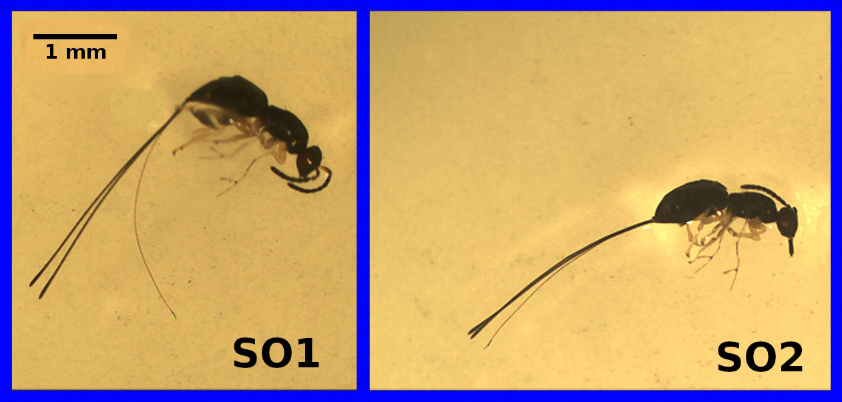
An instructive example
Two fig wasps with (relatively) short ovipositors

Slide 6
An instructive example
Species | Ovipositor length (mm)
SO1 | 3.256
SO1 | 3.133
SO1 | 3.071
SO1 | 2.299
SO1 | 2.995
SO1 | 2.929
SO1 | 3.291
SO1 | 2.658

Slide 7
An instructive example
Standard approach would be to use a two sample t-test:
Null hypothesis: the two means are the same
Alternative hypothesis: the two means are not the same (two-sided)
Check t-test assumptions:
Data are normally distributed
Both samples have similar variances
If data are not normally distributed, use a Mann Whitney test instead

Slide 8


An instructive example
Calculate the t-statistic
The s_{p} is just being used as a short-hand to indicate the pooled standard deviation,
Values of n1 and n2 are the sample sizes for SO1 (17) and SO2 (15), respectively, and s²₁ and s²₂ are the sample variances for SO1 and SO2, respectively.

Slide 9
An instructive example
Mean ovipositor lengths:
SO1: 3.0301176 mm
SO2: 2.8448667 mm
Calculate our t-statistic, then get p-value with critical value table or SPSS:
t-statistic (30 df): 2.4190497
p-value: 0.0218352
Hence, we would reject our null hypothesis and conclude that the difference between the group means is statistically significant.

Slide 10
An instructive example
Randomisation approach: If there really is no difference between group means, then we should be able to randomly shuffle group identities (species) and get a difference between means that is not far off the one we actually get from the data.
Shuffle the identities all of the species
Calculate the mean between shuffled groups
Repeat steps 1 and 2 many times
Compare the shuffled mean differences to the actual one
This app illustrates how the process works.

Slide 11
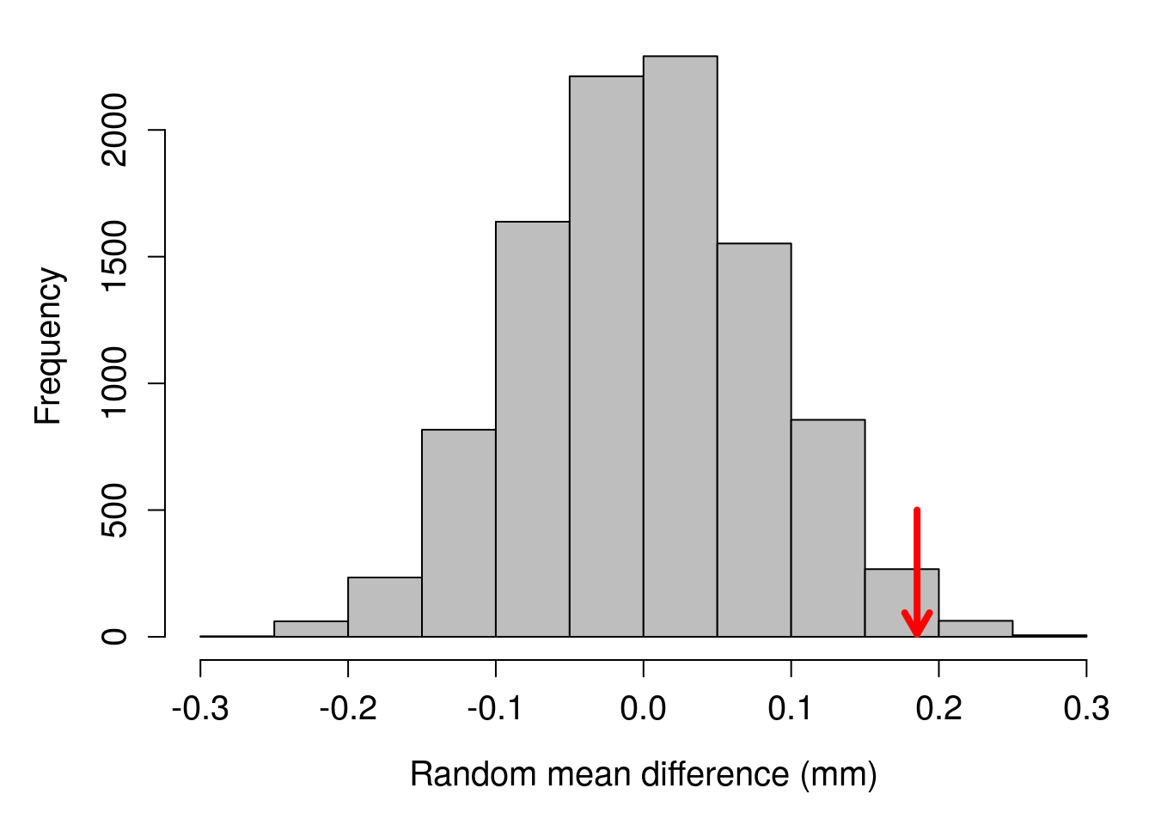
An instructive example

Slide 12
An instructive example
Comparing the observed distance to the random mean differences:
Observed difference was 0.185251
213 random differences were more extreme (above 0.185251 or below -0.185251)
Probability of value as or more extreme
P = (213 + 1) / (9999 + 1)
Compare the randomisation and traditional approaches:
Randomisation P value: 0.0214
Traditional t-test p-value: 0.0218

Slide 13
Randomisation is a general tool
Species | Ovipositor length (mm)
SO1 | 3.256
SO1 | 3.133
SO1 | 3.071
SO1 | 2.299
SO1 | 2.995
SO1 | 2.929
SO1 | 3.291
SO1 | 2.658
SO1 | 3.406

Slide 14
Randomisation is a general tool
Species | Ovipositor length (mm)
2.823 | 3.256
2.948 | 3.133
2.641 | 3.071
2.346 | 2.299
2.406 | 2.995
2.928 | 2.929
3.128 | 3.291
2.187 | 2.658
4.017 | 3.406

Slide 15
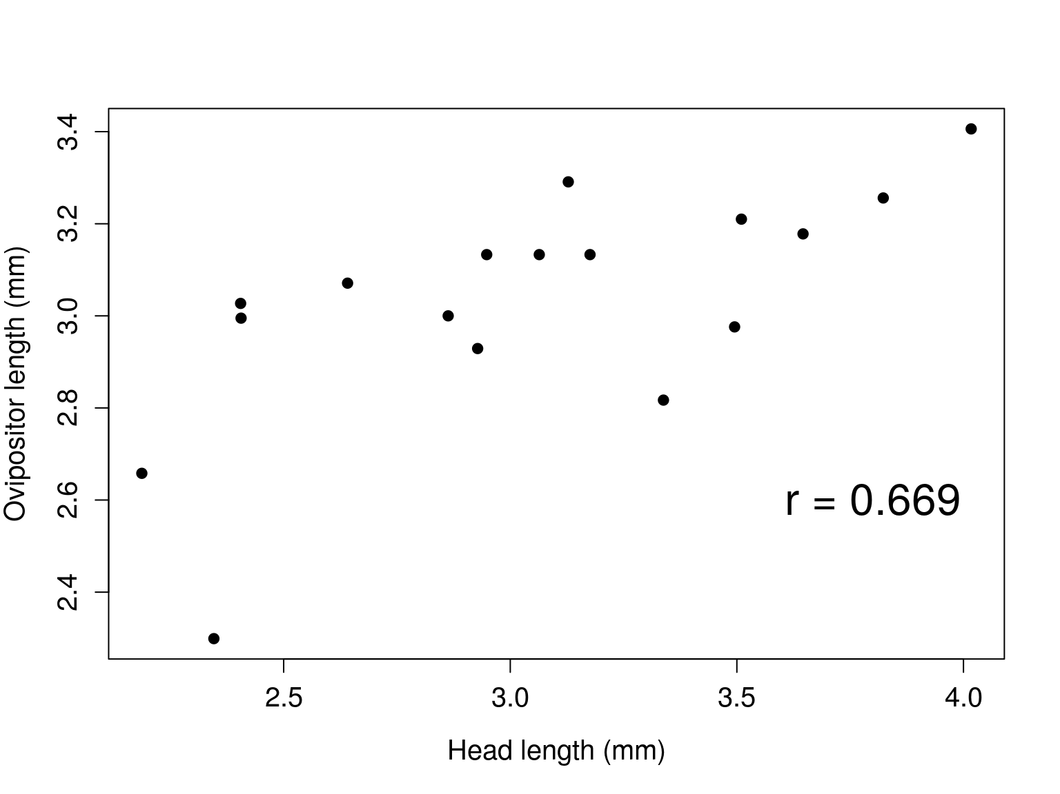
Randomisation is a general tool

Slide 16
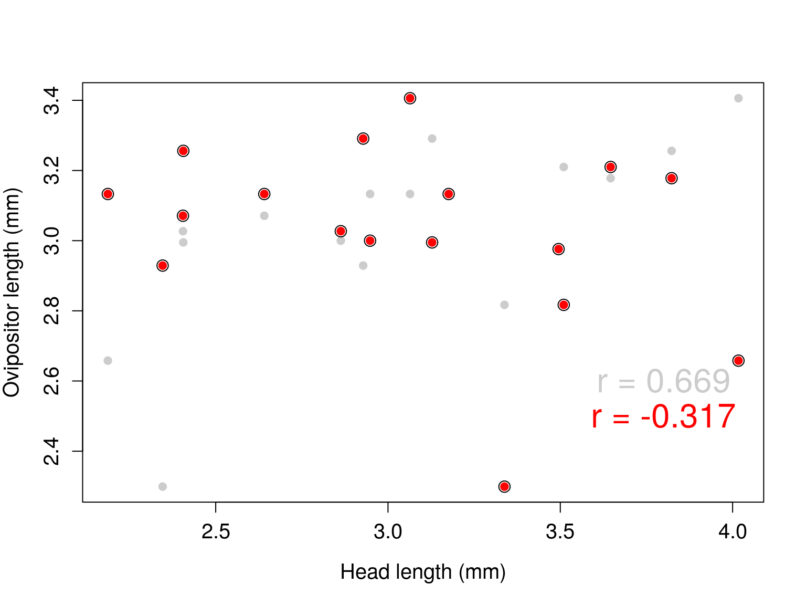
Randomisation is a general tool

Slide 17
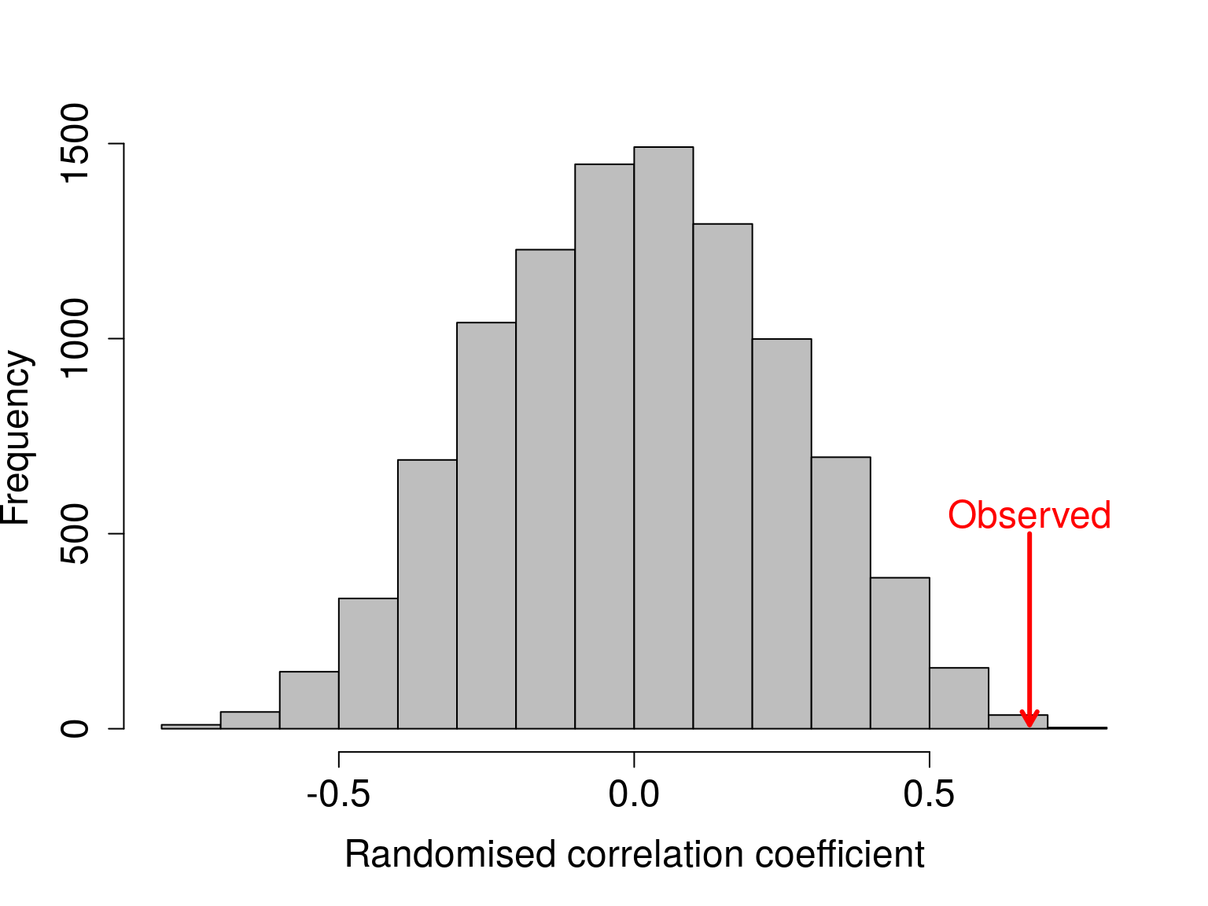
Randomisation is a general tool

Slide 18
Introduction to the randomisation approach
After randomising ovipositor length values 9999 times, 27 values more extreme than observed correlation (i.e., > 0.669 or < -0.669)
P = (27 + 1) / (9999 + 1) = 0.0028.
Traditional Pearson product moment p-value:
P = 0.003293.

Slide 19
Assumptions of randomisation tests
Assumptions of two sample t-test:
Data from indendent groups
The data are normally distributed
Observations independent of each other
Both samples have similar variances
With randomisation, we do not need to assume 1-3

Slide 20
Assumptions of randomisation tests
The downsides of randomisation:
Statistical inferences are limited to the sample (not the population)
This is because no formal assumption of random sample from populations
Can still make the verbal argument generalising from sample to populations [1, 2]
1. Ernst, M D. 2004. Stat. Sci. 19:676-685.
2. Ludbrook, J, & H Dudley. 1998. Am. Stat., 52:127-132.

Slide 21
Bootstrapping confidence intervals
We can use randomisation to calculate confidence intervals (CIs)
Recall the traditional approach to calculating CIs:
Upper CI: mean + constant * standard error
Lower CI: mean - constant * standard error
Calculating standard error:
SE = s / sqrt(n)
Above, s is the standard deviation and n is the sample size.

Slide 22
Bootstrapping confidence intervals
We can use randomisation to calculate confidence intervals (CIs)
Recall the traditional approach to calculating CIs:
Upper CI: mean + constant * standard error
Lower CI: mean - constant * standard error
Finding the right constant
Appropriate z score or t score
Encompasses correct probability density
E.g., 95 per cent of standard normal distribution between z = -1.96 and 1.96

Slide 23
Bootstrapping confidence intervals
Values of SO1 ovipositor length:
3.256, 3.133, 3.071, 2.299, 2.995, 2.929, 3.291, 2.658, 3.406, 2.976, 2.817, 3.133, 3.000, 3.027, 3.178, 3.133, 3.210
Mean: 3.0301
Standard error: 0.0631
t-score for df = 17 – 1: 2.120
Upper CI: 3.0301 + 2.120(0.0631) = 3.164
Lower CI: 3.0301 - 2.120(0.0631) = 2.896

Slide 24
Bootstrapping confidence intervals
Randomisation approach:
Resample the data with replacement many times
Approximate what would happen if we went out and collected more data from the population
Get the distribution of means from hypothetical resampling [1]
Rank random means, get lower 2.5% and upper 97.5% of ranked values
1. Manly, B F J. 2007. Randomization, Bootstrap and Monte Carlo Methods in Biology (3rd ed.). Chapman & Hall/CRC.

Slide 25
Bootstrapping confidence intervals
Original SO1 ovipositor length values:
3.256, 3.133, 3.071, 2.299, 2.995, 2.929, 3.291, 2.658, 3.406, 2.976, 2.817, 3.133, 3, 3.027, 3.178, 3.133, 3.21
SO1 ovipositor values resampled with replacement
3, 3.027, 2.929, 3.291, 3.291, 2.976, 2.299, 2.299, 3.027, 3.027, 3.133, 3.027, 2.299, 3.133, 2.299, 3.178, 3.133
Bold values appear multiple times in resampling
Original values 3.256, 3.071, 2.995, 2.658, 3.406, 2.817, and 3.21 do not appear at all in resampling
Now we calculate the mean of our values resampled with replacement 10000 times.

Slide 26
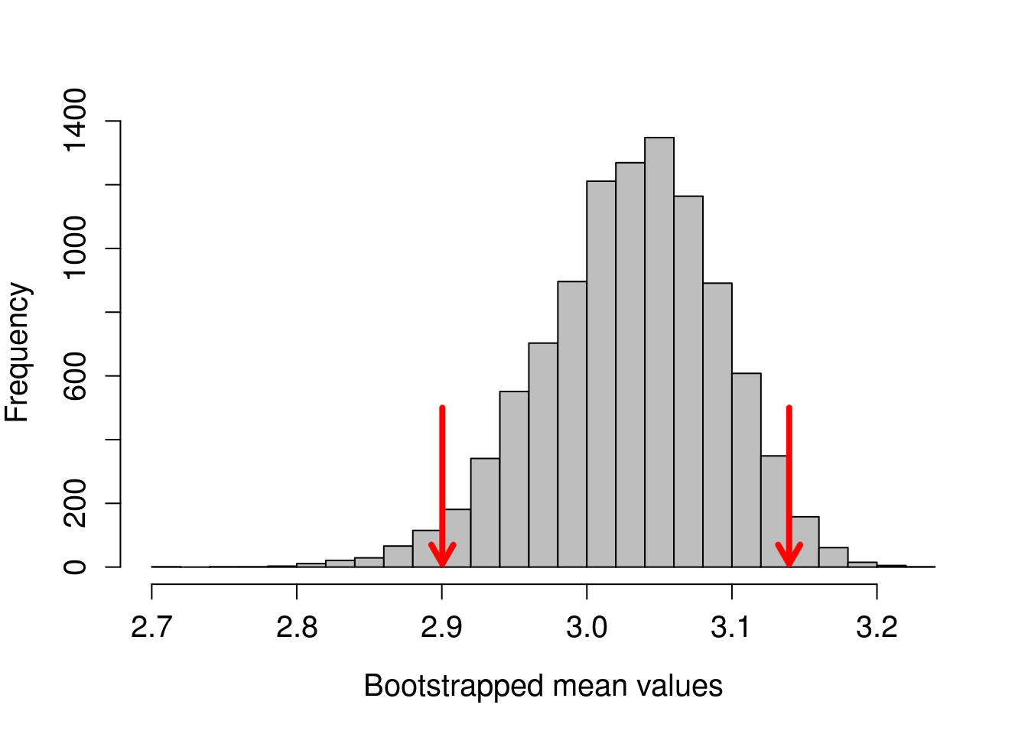
Bootstrapping confidence intervals

Slide 27
Bootstrapping confidence intervals
Confidence intervals with bootstrapping:
UCI: 3.1394706
LCI: 2.9003529
Traditional confidence intervals:
UCI: 3.1638125
LCI: 2.8964228

Slide 28
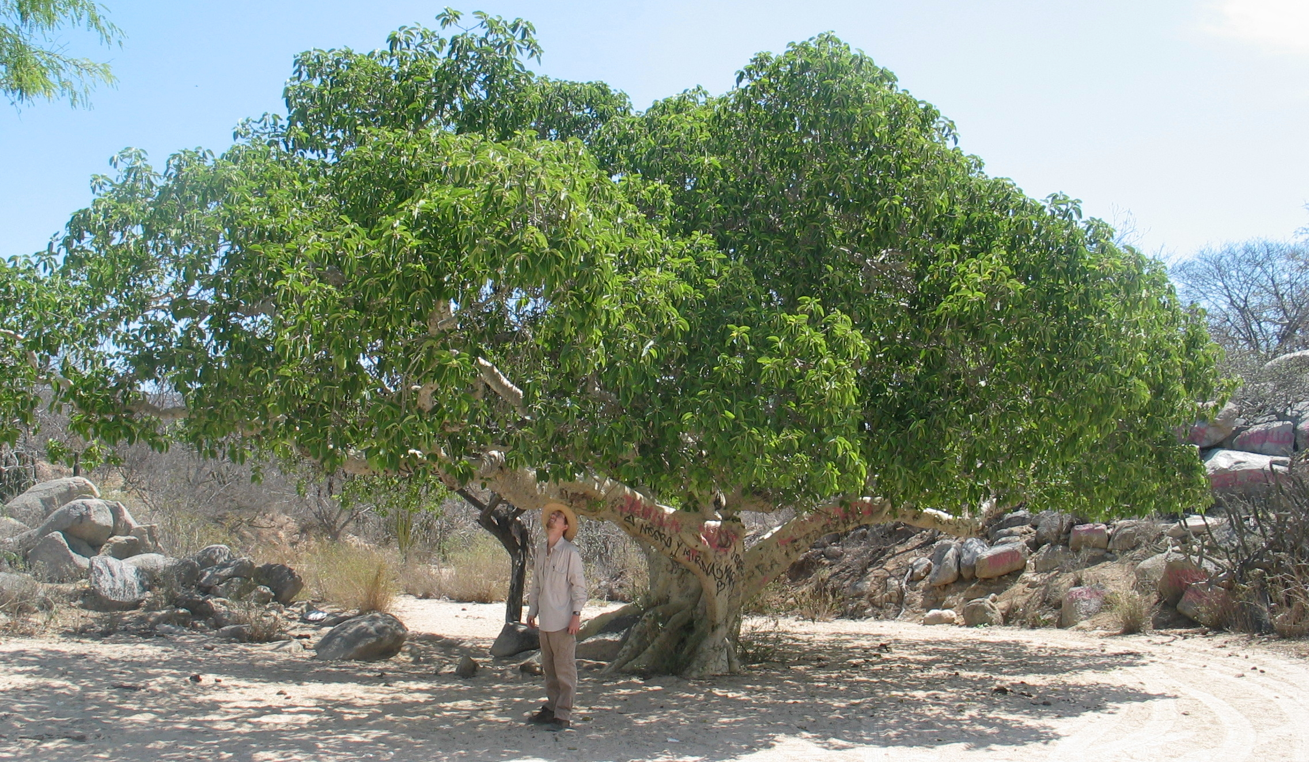
Monte Carlo on spatial data
We can also use randomisation when a null distribution cannot be derived from the data.
Are fig trees randomly distributed across a sampling area?

Slide 29
Monte Carlo on spatial data
Site | Tree | Latitude | Longitude | Elevation
S172 | T34 | 28.29021 | -113.1116 | 718.2859
S172 | T01 | 28.29141 | -113.1117 | 664.8726
S172 | T02 | 28.29130 | -113.1118 | 652.8560
S172 | T03 | 28.29129 | -113.1126 | 663.6709
S172 | T04 | 28.29127 | -113.1127 | 653.3367
S172 | T05A | 28.29110 | -113.1125 | 676.8889

Slide 30
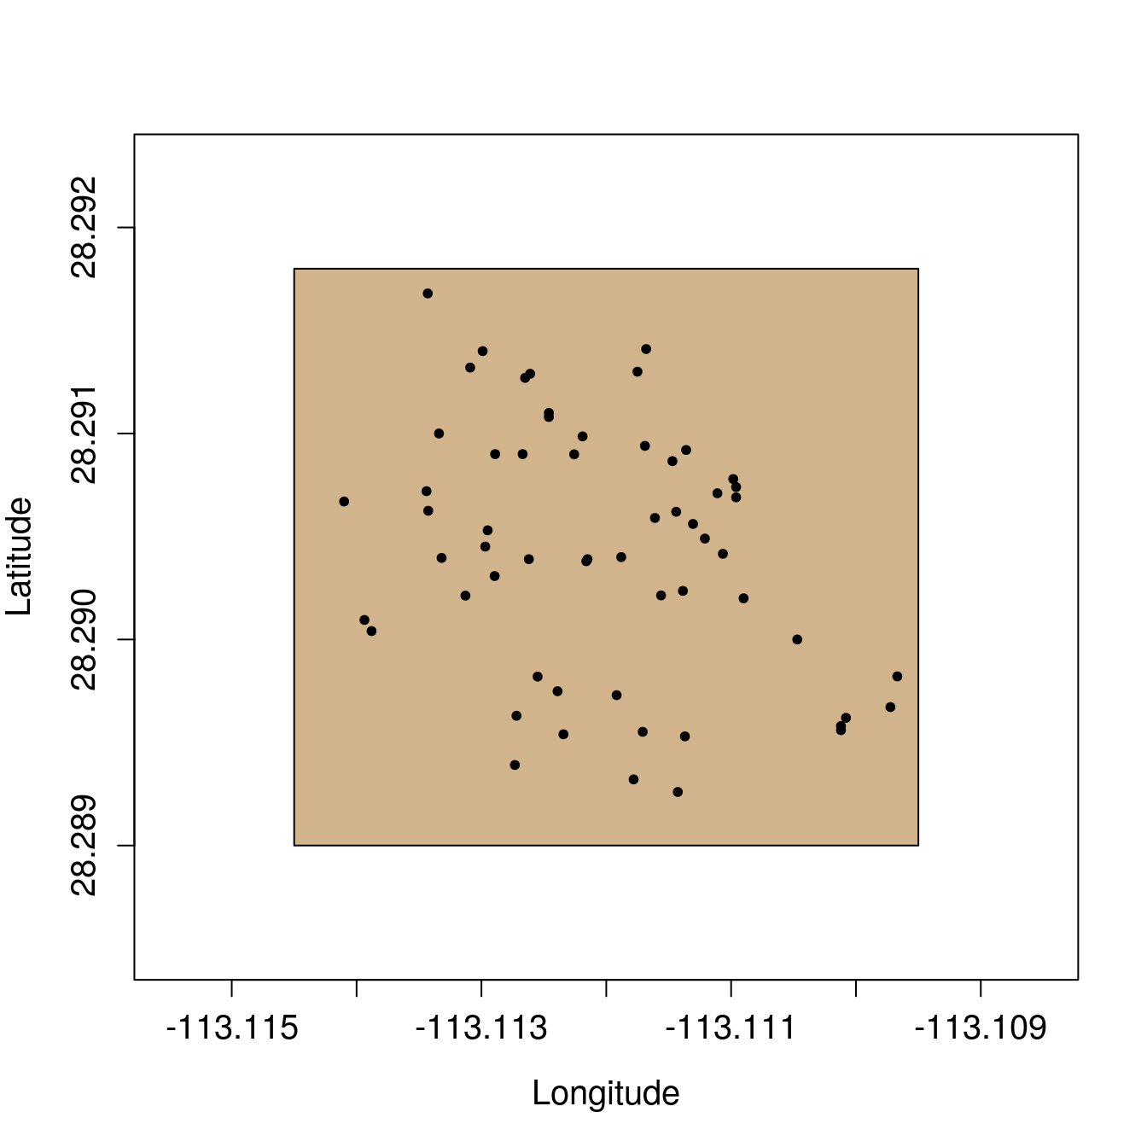
Monte Carlo on spatial data

Slide 31
Monte Carlo on spatial data
Are the trees randomly distributed in the brown box?
Cannot randomise latitude and longitude coordinates
Want to compare actual tree distribution with randomly placed trees
Monte Carlo compares observed test statistic with one derived from theoretical null [1]
Use mean distance to nearest neighbour as a test statistic
1. Manly, B F J. 2007. Randomization, Bootstrap and Monte Carlo Methods in Biology (3rd ed.). Chapman & Hall/CRC.

Slide 32
Monte Carlo on spatial data
Null Hypothesis: Mean nearest neighour distance for a focal tree in the observed data will not differ significantly from the mean nearest neighbour distance obtained from the same number of trees randomly distributed within the sampling area.
Randomly place 59 trees in the sampling area
Calculate mean nearest neighbour distance of random trees
Repeat steps 1 and 2 many times
Generate a null distribution of nearest neighbor distances
Compare actual mean nearest neighbour distance will null distribution

Slide 33
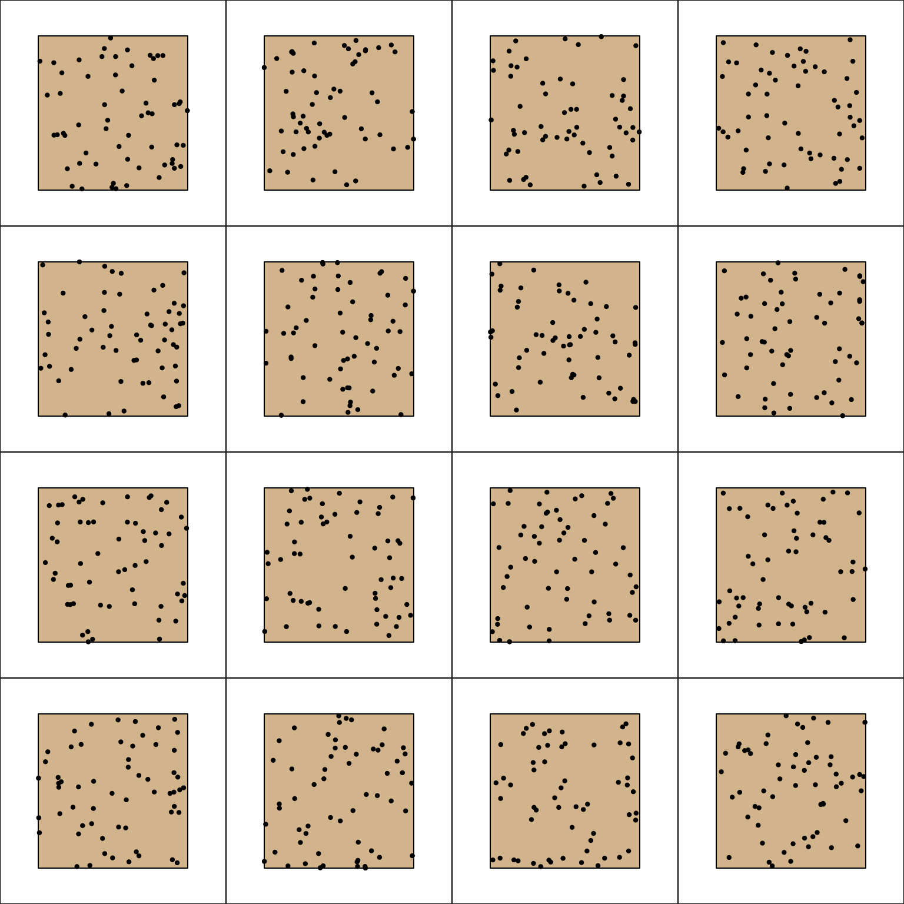
Monte Carlo on spatial data

Slide 34
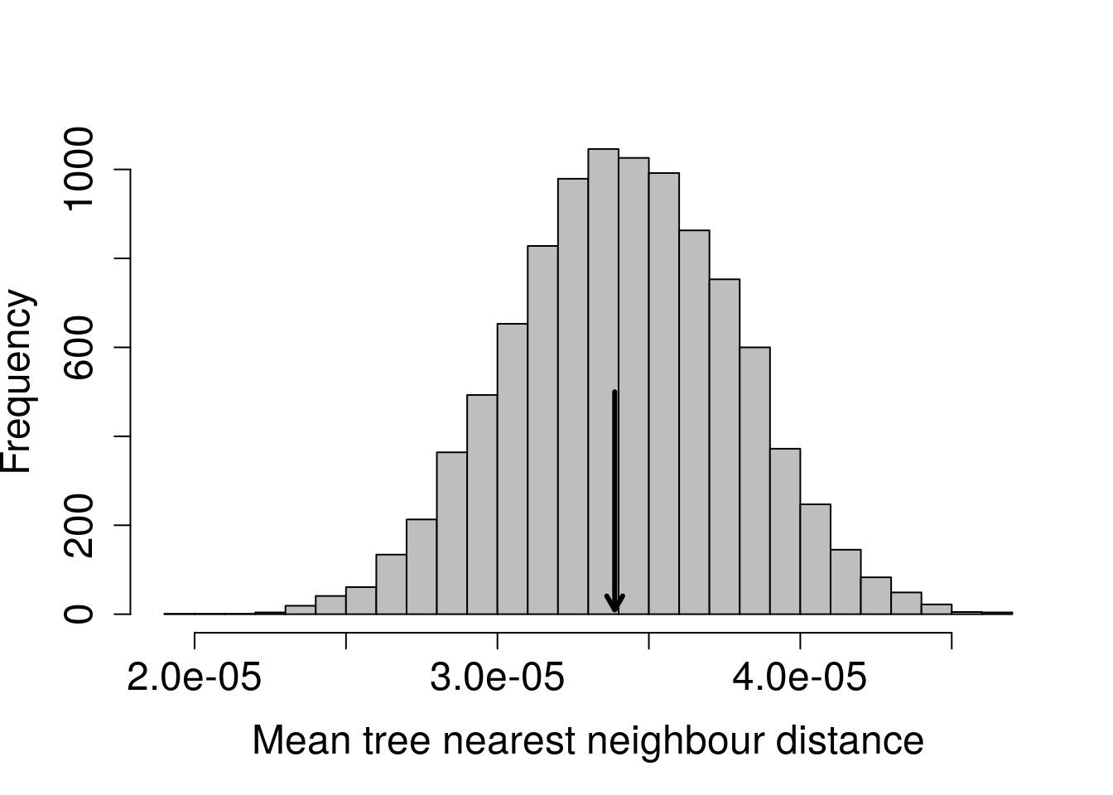
Monte Carlo on spatial data

