Slide 1
Reporting statistical analyses

Slide 2
Describing and reporting statistics
Have focused on how to analyse and present graphics and statistics
Important to present statistics clearly in scientific writing
Need to plan ahead when setting up experiments and collecting data
Without a plan, might collect the wrong data for scientific hypothesis
Consult a statistician early in the process if possible

Slide 3
Presenting hypotheses
Important to recognise the difference between scientific and statistical hypotheses
Statistical hypotheses simply state whether or not a pattern or trend exists in the data
Scientific hypotheses attempt to explain a set of observations in the world
When writing a scientific report, the scientific hypotheses should usually be the central focus of the writing.
Usually best placed at the end of an introduction
Generally good to briefly explain how hypothesis will be tested
There are always exceptions in the scientific literature, but clear hypotheses (sometimes expressed as questions) are usually presented toward the end of the introduction.

Slide 4
Presenting hypotheses
"The purpose of this study was to address the critical lack of knowledge regarding the potential value of forest strips in the tropics by examining 30-year-old terra firme and riparian forest strips in the north-east Brazilian Amazon. [...] To do this we examined patterns of abundance and occupancy of bird species already identified as characteristic of continuous primary forest [...]. Specifically, we test the a priori hypotheses that (1) bird species richness and community structure in remnant forest strips will be clearly distinct from bird assemblages in continuous primary forest, (2) bird species richness and community structure will become more similar to the matrix avifauna with increasing distance from adjoining areas of continuous forest" [1].
1. Hawes, J et al. 2008. Biol. Conserv. 141:2262-2278.

Slide 5
Presenting hypotheses
"In the present study we examine which abiotic factor(s) (light, nutrient, and/or water availability) are most important in determining species habitat associations at [Sepilok Forest Reserve] and test the importance of differential resource-use efficiency in predicting these associations. Specific hypotheses are as follows: (1) sandstone species are more conservative in their water use than alluvial specialists [...] and (5) although species may show acclimation responses when grown on their nonnative soil type, alluvial specialists are genetically constrained such that they do not perform as sandstone specialists when grown on sandstone soils, and vice versa" [1].
1. Baltzer, JL et al. 2005. Ecology 86:3063-3077.

Slide 6
Presenting Methods
Important to explain statistical analyses in sufficient detail so that the reader could replicate them.
Statistical analyses often explained in its own paragraph or sub-section toward the end of the Methods
If necessary, supporting information can be used when a lot of analyses need to be explained
Ideally, data and code for replicating the analyses would be included with the report or paper
Not all papers in the literature meet the standards listed above, but there is a general move towards more open science.

Slide 7
Presenting Methods
"Because stigmatic pollen counts were not normally distributed, they were analysed using non-parametric statistics (Mann-Whitney U test) for pairwise comparisons among four times of collection at the 0.05 level of significance. All data analysis was conducted in SPSS, version 17.0. All means are presented with standard errors (± SE)" [1].
1. Xiong, Y-Z et al. 2013. AoB PLANTS 5:plt037.

Slide 8
Presenting Methods
"All statistical analyses were carried out using R 3.1.0 (R Core Team 2012). [...] ANOVAs were carried out to test whether the three soil-conditioning treatments affected plant biomass and trait and soil N availability, and whether there was an effect of drought, with a two-way interaction term between soil conditioning and drought. Non-constancy of variances was evaluated using Levene's test in the car package of R (Levene 1960), and normality was ascertained and corrected for where necessary using Box–Cox transformations in the MASS package (Box and Cox 1964)" [1].
1. Fry, EL et al. 2018. Oecologia 186:1113-1125.

Slide 9
Presenting Results
Primary focus should be on the biological or environmental patterns
Inferences about patterns should be supported by statistical analyses
Figures and tables can also illustrate patterns in the data
Figure and table legends should stand alone for interpretation

Slide 10
Presenting Results
"The pollen grain counts on the stigma increased significantly during two different periods of anthesis. Pollen deposition was low in flowers on the first day of opening (18.9 ± 7.5 grains), but it increased significantly after flowers had experienced one night's closure (247.1 ± 79.1, Mann-Whitney U test, Z = -3.16, P < 0.001). The same situation of a rapid increase in pollen loads occurred during flower closure on the second evening of anthesis (Z = -2.96, P < 0.001; Fig. 4). In the second-day flowers, pollen loads were not significantly different between stigmas collected in the morning and late afternoon (Z = -0.415, P = 0.678)" [1].
±
1. Xiong, Y-Z et al. 2013. AoB PLANTS 5:plt037.

Slide 11
Presenting Results
"For soil planted with S. minor, microbial community composition was affected by drought (Fig. 1c; stress: 0.032, k = 2, R² = 0.39, P < 0.001), although no impacts of conditioning were detected (R² = 0.04, P = 0.66). Total PLFA, a measure of active microbial biomass, was significantly greater in droughted soil (Table S2: F_{1,22} = 10.71, P = 0.004), as was bacterial PLFA (F_{1,22} = 17.58, P < 0.001)" [1].
±
1. Fry, EL et al. 2018. Oecologia 186:1113-1125.

Slide 12
Presenting Results for t-tests
Report degrees of freedom (df), the t value, and the p-value.
  The two groups differed significantly from each other (t₍₁₄₎ = 9.56, P = 0.02).

Slide 13
Presenting Results for one-way ANOVA
Report F value, p-value, and degrees of freedom for the effect and error terms.
  Plant height different significantly as a function of soil type (F_{(2, 25)} = 11.37, P < 0.001)

Slide 14
Presenting Results for one-way ANOVA
A two-way ANOVA reports the same values, but includes main effects and interactions.
  The main effect of soil type was significant (F_{(2, 25)} = 7.91, P = 0.002), as was the main effect of plant species (F_{(3, 25)} = 12.70, P < 0.001). The interaction of these two factors was not significant (F_{(6, 25)} = 1.71, P = 0.160).

Slide 15
Presenting Results for Mann-Whitney test
Include the W statistic and the p-value.
  The total length of sparrows differed significantly with the survival status of sparrows (W = 1596.5, P = 0.002).

Slide 16
Presenting Results for Wilcoxon signed-rank test
Include the W statistic and p-value as with the Mann-Whitney test.
  Photosynthetic rate significantly in plants before and after frost (W = 14.01, P = 0.007).

Slide 17
Presenting Results for Correlation coefficient test
Presenting Results for Correlation coefficient test
  Egg production was positively correlated with body mass (r = 0.8977, P = 0.0379).

Slide 18
Presenting Results for Regression
Report the R-squared value, regression coefficients, and p-values of model or regression coefficients.
  Sparrow body mass (g) increased significantly with sparrow total length (mm; R-squared = 0.341, b = 0.2419, P < 0.001) according to the model, mass = -13.07 + 0.2419(length).
Multiple ways to present information clearly
For multiple regression use β coefficients
Often helps to present results in a table format

Slide 19

Everyday use of statistics
Be sceptical about statistical claims
"80% of dentists recommend our brand!"
1. Image: Steve Buissine; Public Domain

Slide 20
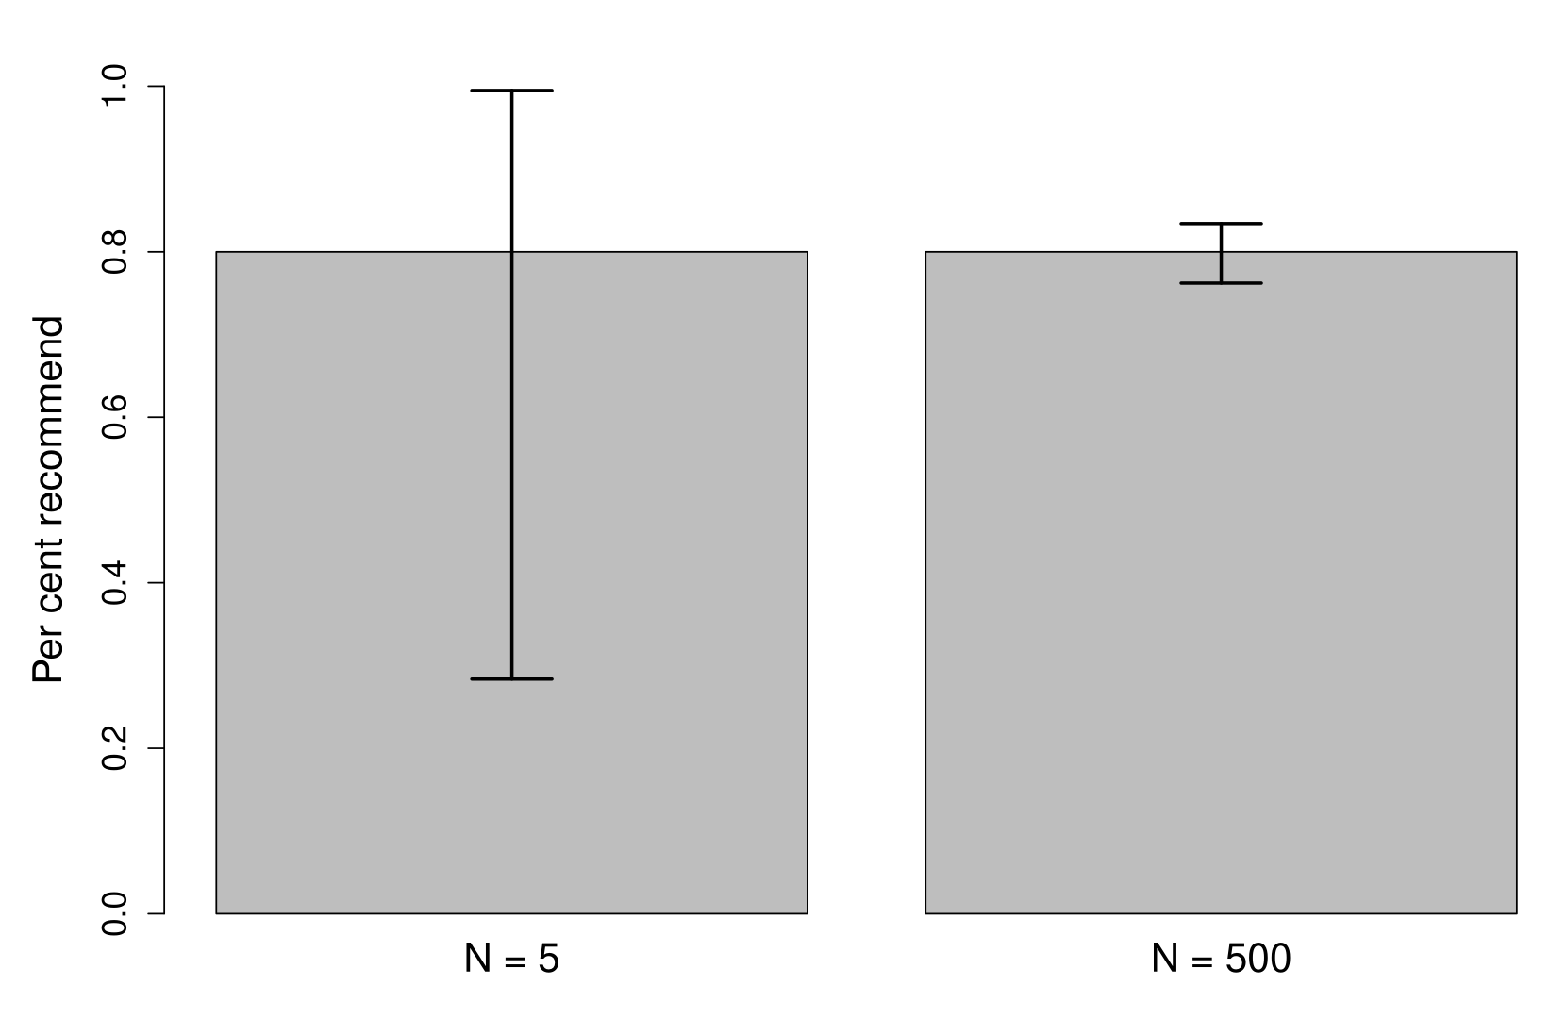
Everyday use of statistics

Slide 21

Everyday use of statistics
Be sceptical about statistical claims
"Average graduate salary is 80k GBP!"
1. Image: Public Domain

Slide 22
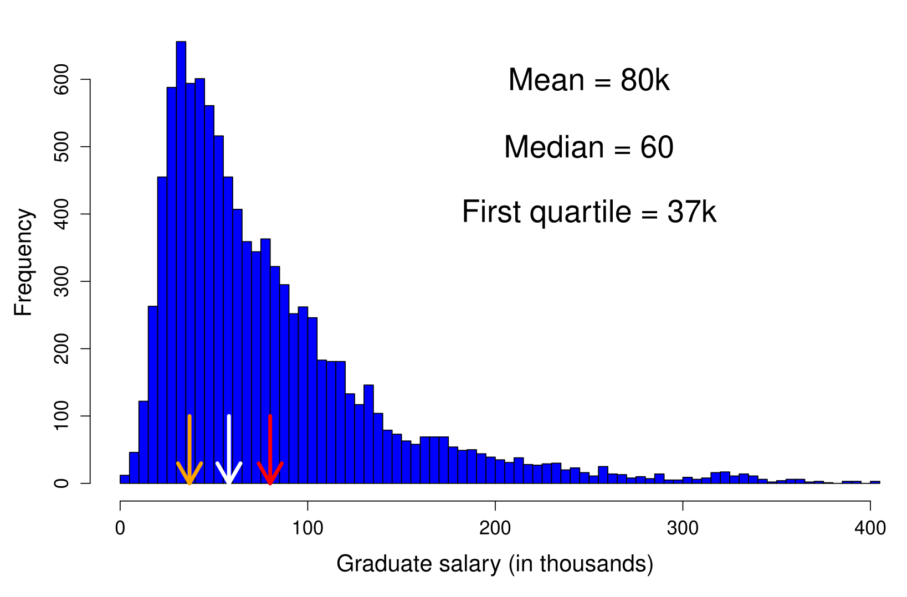
Everyday use of statistics

Slide 23

Everyday use of statistics
Be sceptical about statistical claims
"Grey ball is scientifically proven to significantly increase your sleep!"
1. Image: Public Domain

Slide 24
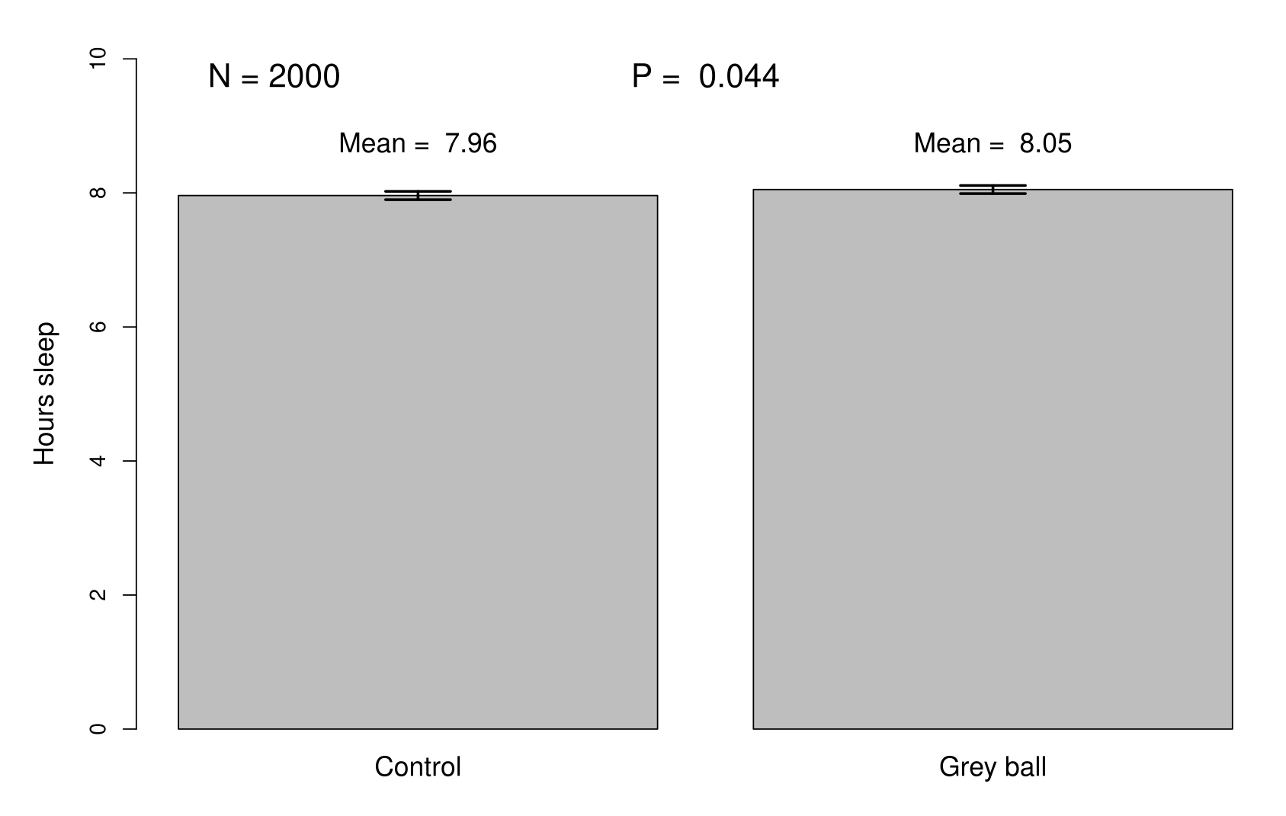
Everyday use of statistics

Slide 25
Statistical errors in science
"[W]e continuously increased [our sample size] until statistical significance was reached to support our conclusions."
Paper in Nature Communications

Slide 26
Statistical errors in science
set.seed(202549);
N <- 20;
Group_A <- rnorm(n = N, mean = 100, sd = 10);
Group_B <- rnorm(n = N, mean = 100, sd = 10);
pvals <- NULL;
max_N <- 10000;
while(N < max_N){
new_p <- t.test(Group_A, Group_B)$p.value;
pvals <- c(pvals, new_p);
new_A <- rnorm(n = 1, mean = 100, sd = 10);
new_B <- rnorm(n = 1, mean = 100, sd = 10);
Group_A <- c(Group_A, new_A);
Group_B <- c(Group_B, new_B);
N <- N + 1;
}

Slide 27
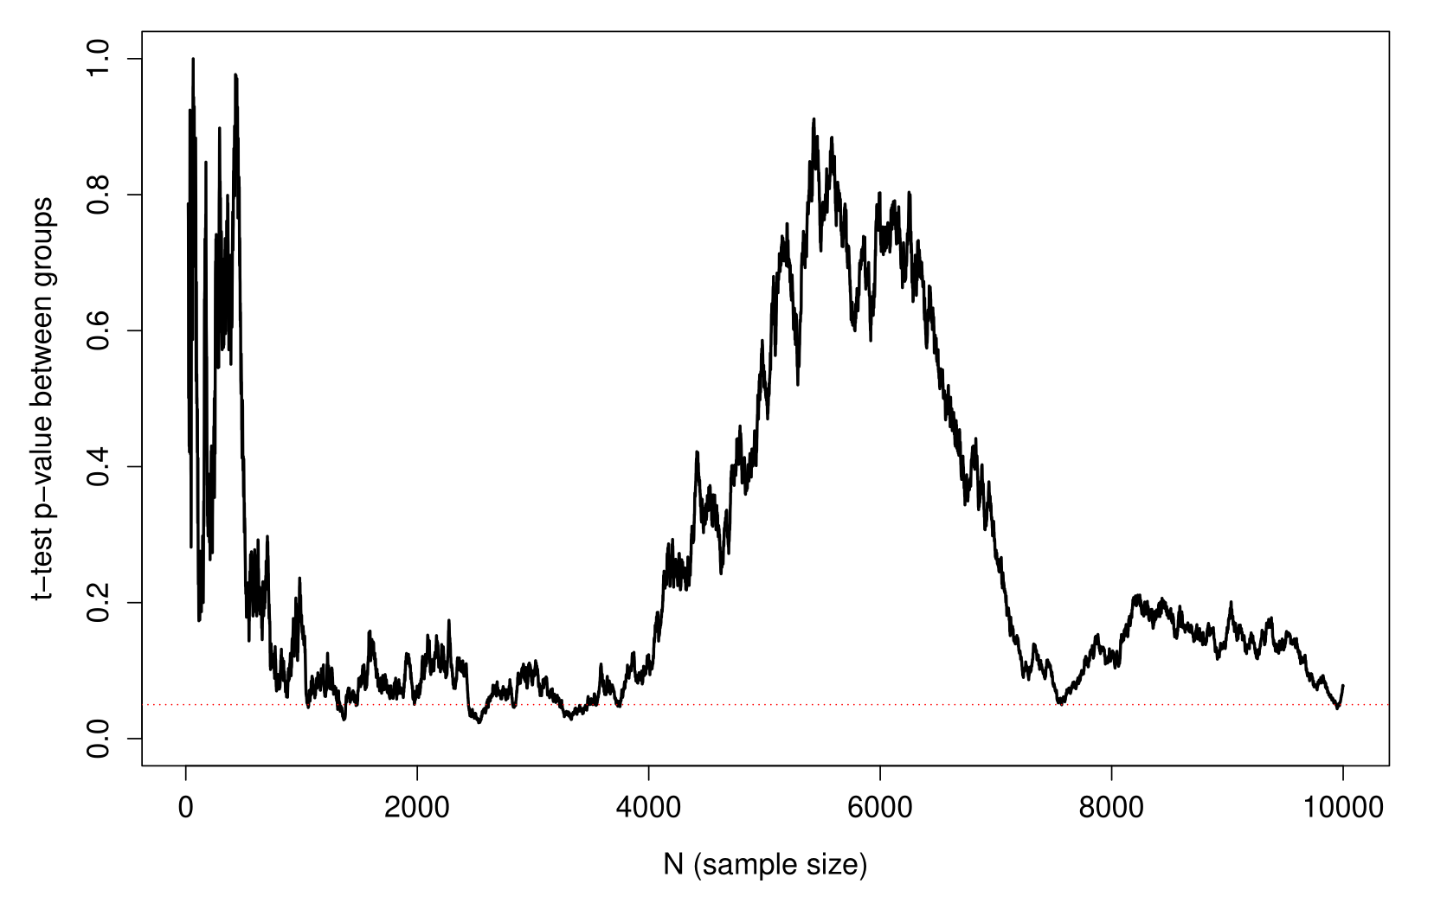
Statistical errors in science

Slide 28
What's next? The R module
Learn to code in R and more stats
Coding and data wrangling
Data visualisation in R
Linear regression
Multiple regression
ANOVA, ANCOVA, interactions
Generalised linear models
Mixed models, GAMs
Understand equivalence of t-tests, ANOVA, regression

