Slide 1
Why study statistics?

Slide 2
Why study statistics?
Importance of good statistics
Statistical revolution
Populations and samples
Expectations and uncertainty
Types of variables

Slide 3
Importance of good statistics
Florence Nightingale
Pioneer of modern nursing and statistics
Founded first secular nursing school 1860
Nurse during Crimean war (1853-1856)
16k of 18k deaths due to sanitation
Fatalities plummeted after improvements
Persuaded parliament to reform hospitals

Slide 4
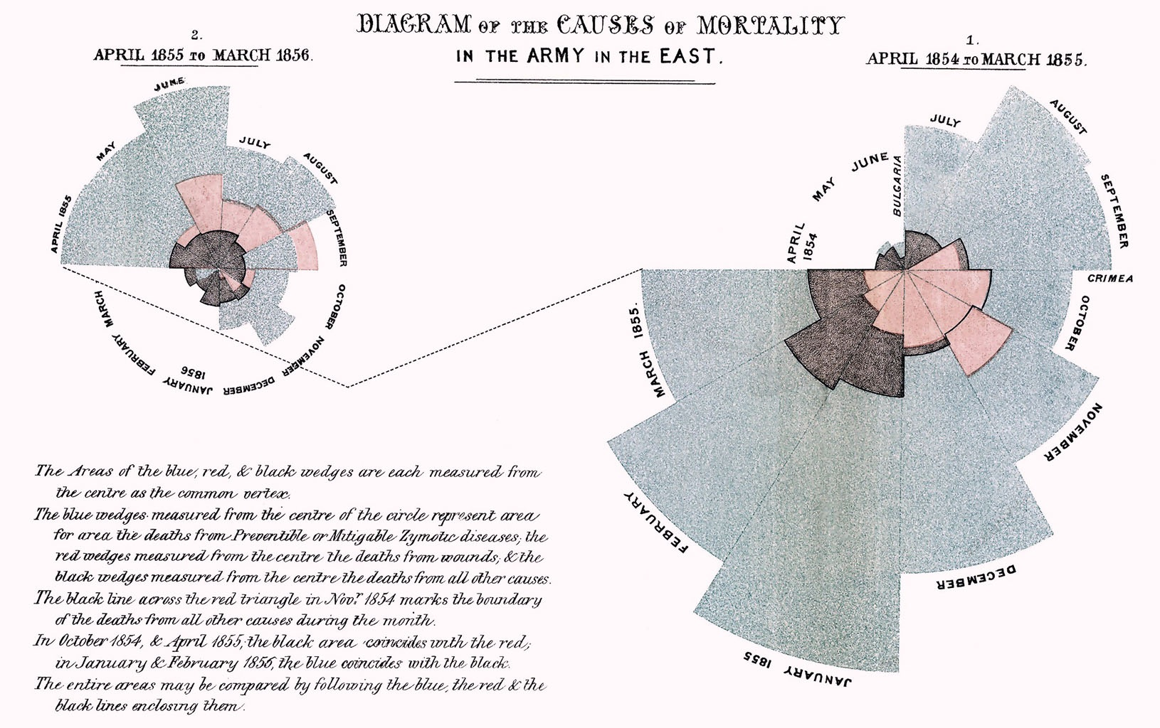
Importance of good statistics
Image: Notes on Matters Affecting the Health, Efficiency, and Hospital Administration of the British Army (Public domain).

Slide 5
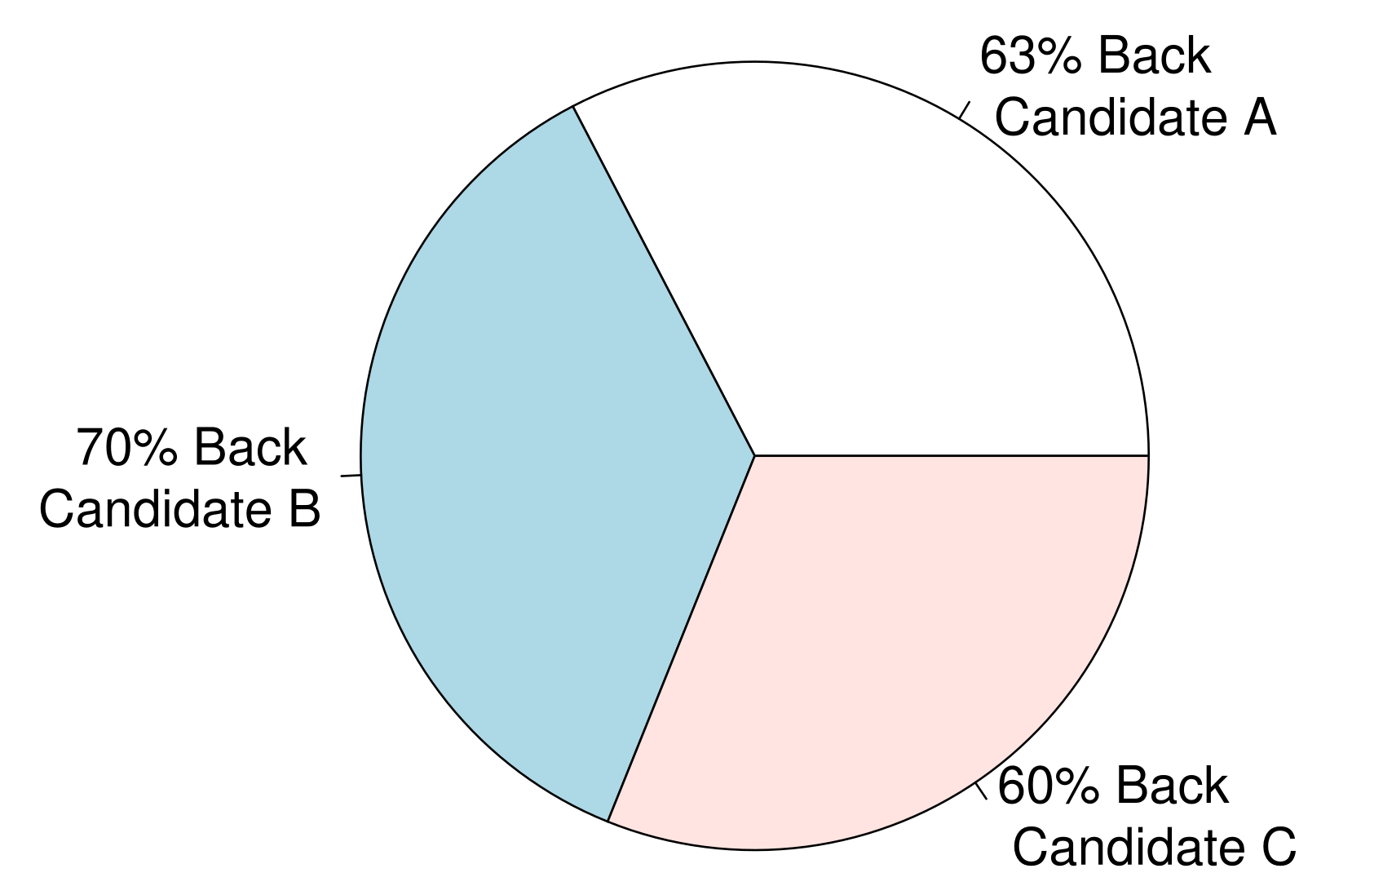
Importance of good statistics
Source: A widely watched news channel

Slide 6
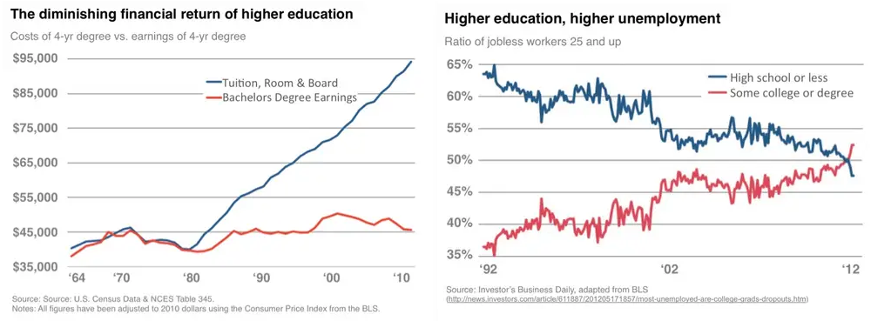
Importance of good statistics
Sometimes graphs do not tell the full story
What about the earnings for people without a degree over time?
Blake, D. 2012. These Two Charts Prove A College Education Just Isn’t Worth The Money Anymore https://www.businessinsider.com/these-two-charts-prove-a-college-education-just-isnt-worth-the-money-anymore-2012-6.

Slide 7
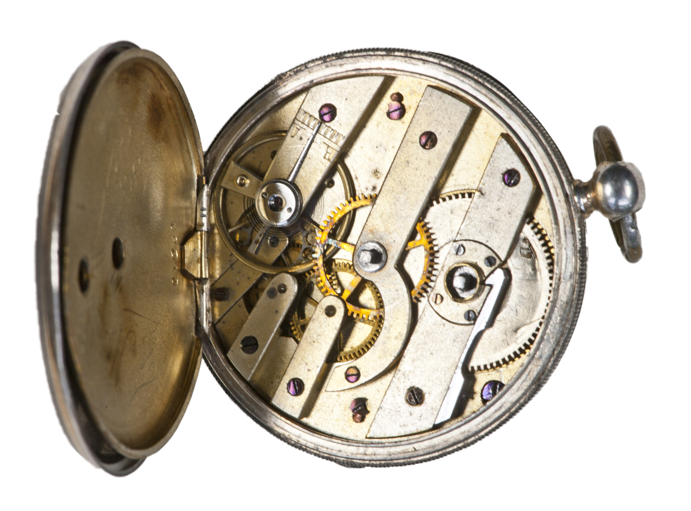
Statistical revolution: Old view of a clockwork universe
Image: Grobe, H. 2017. (Public domain).

Slide 8
Statistial revolution: Old view of a clockwork universe
Newtonian physics success
Formulas for laws of motion
Precise measurement
Eliminate measurement errors
Apply to life sciences?
This old view of eliminating uncertainty was challenged in the early 1900s.¹
Salsburg, D. 2001. The lady tasting tea: How statistics revolutionized science in the twentieth century. Macmillan.

Slide 9
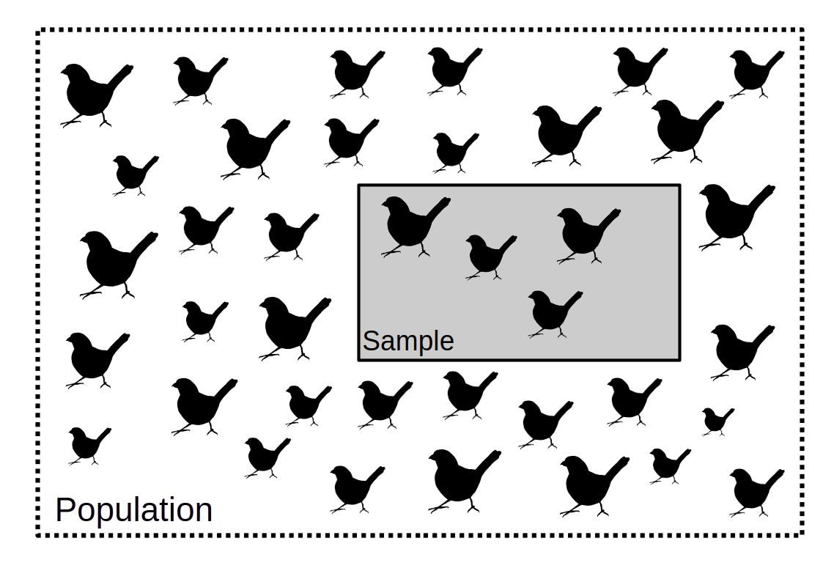
Statistical revolution: A new perspective
Figure 1: Samples are taken from a subset of a population

Slide 10
Statistical revolution: A new perspective
"In statistics, population always means the totality of individual observations about which inferences are to be made, existing anywhere in the world or at least within a definitely specified sampling area limited in space and time"¹
Sokal, Robert R, and F James Rohlf. 1995. Biometry. 3rd ed. W H Freeman & Company, New York, USA.

Slide 11

Populations and samples
Statistical population:
Not necessarily a biological population
Not necessarily an actual population
Might be theoretical, not concrete
Image: Wilson, A. 2019. (Public domain)

Slide 12
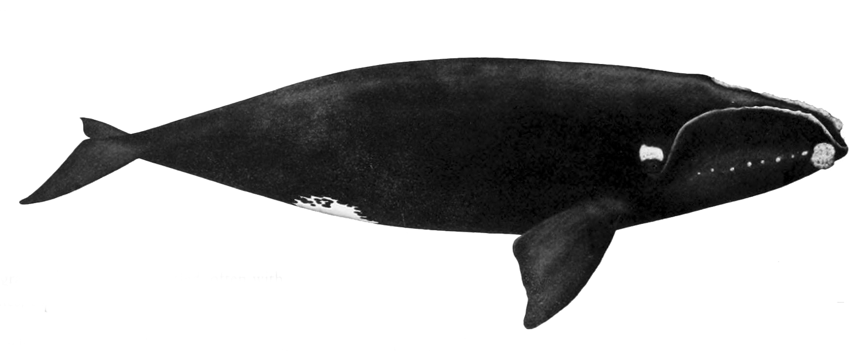
Populations and samples
North Atlantic right whale (Eubalaena glacialis)
Estimated 338 left¹
Conservation requires estimating traits
Average value might not be expected value²
NOAA (2023). North Atlantic right whale (Eubalaena glacialis): Western Atlantic Stock.
van Veelen, M. (2025). The general version of Hamilton’s rule. Elife, 14, RP105065.
Image: NOAA. 1987. (Public domain).

Slide 13
General idea of frequency statistics

Slide 14
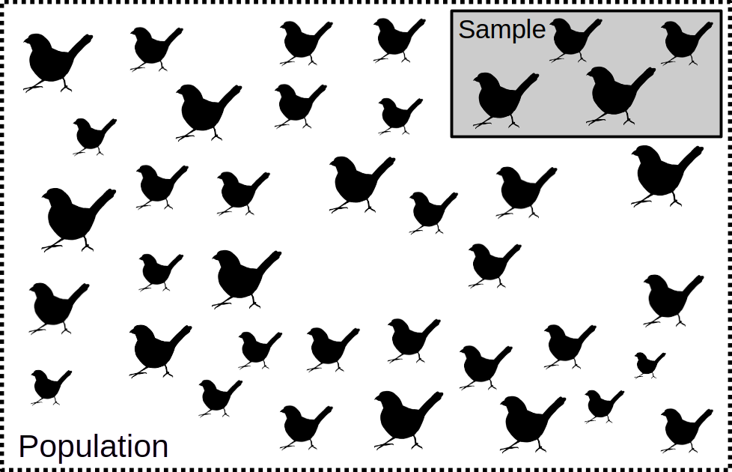
General idea of frequency statistics

Slide 15
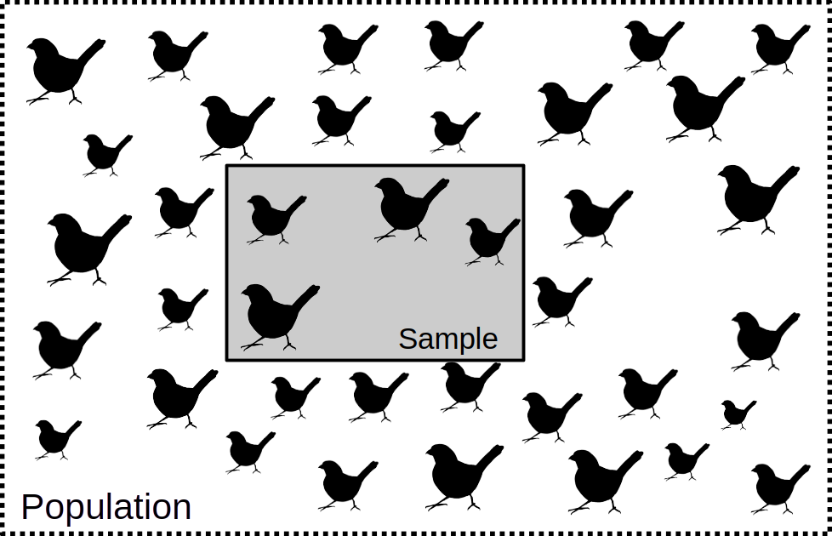
General idea of frequency statistics

Slide 16
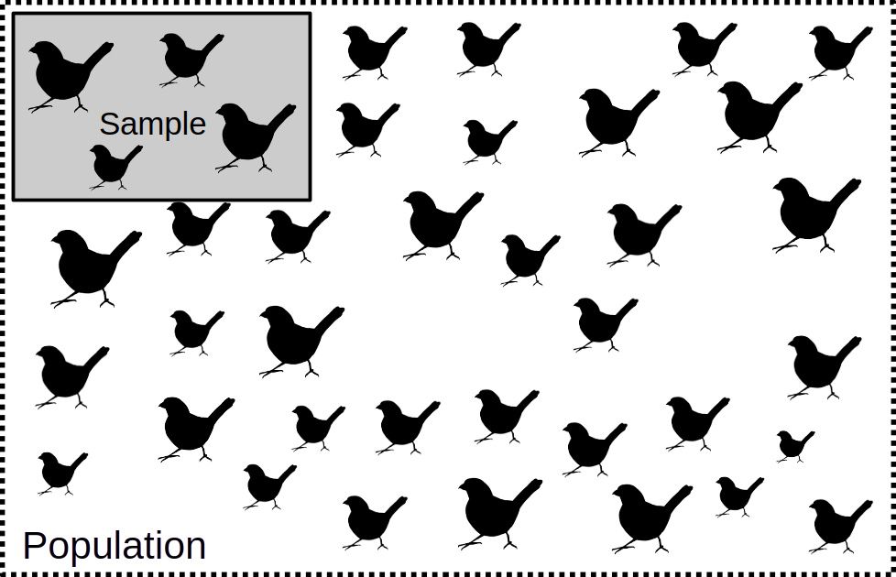
General idea of frequency statistics

Slide 17
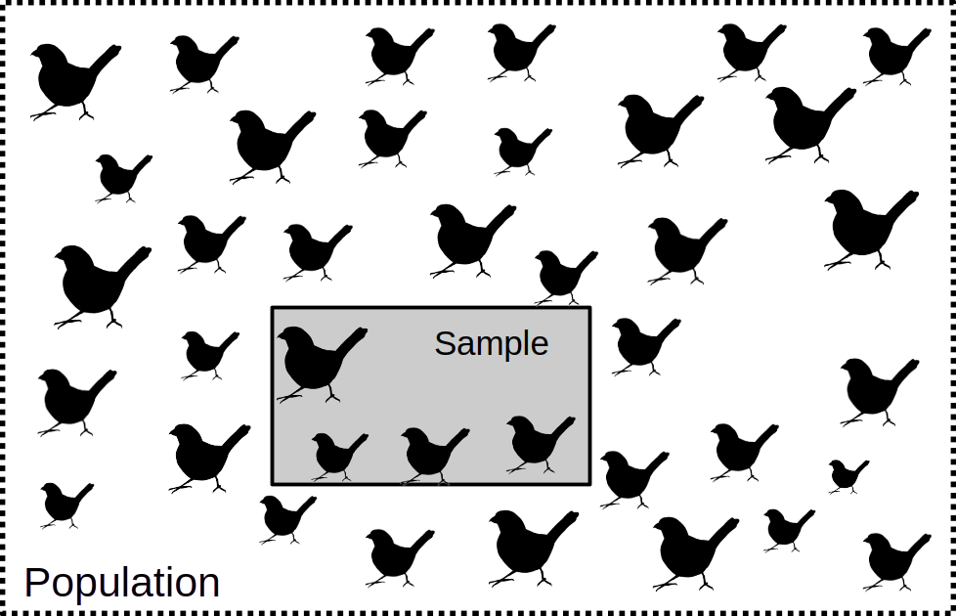
General idea of frequency statistics

Slide 18
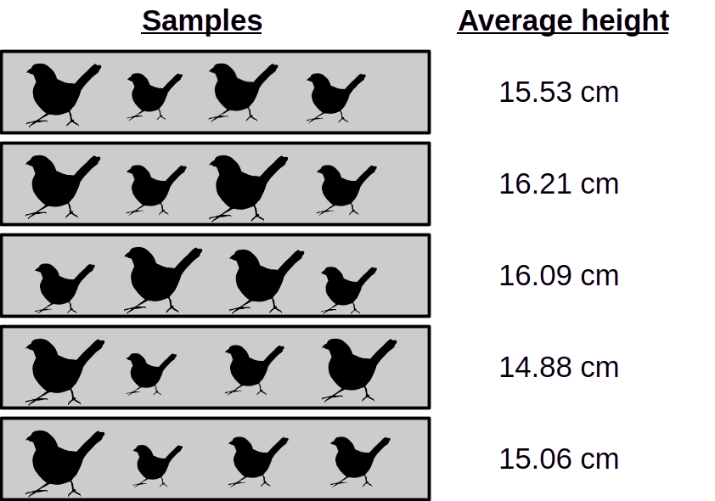
General idea of frequency statistics

Slide 19
General idea of frequency statistics
Repeated re-sampling
What is our expectation?
What is our uncertainty?
Want to get best estimate of true expected measurement and contain uncertainty.

Slide 20
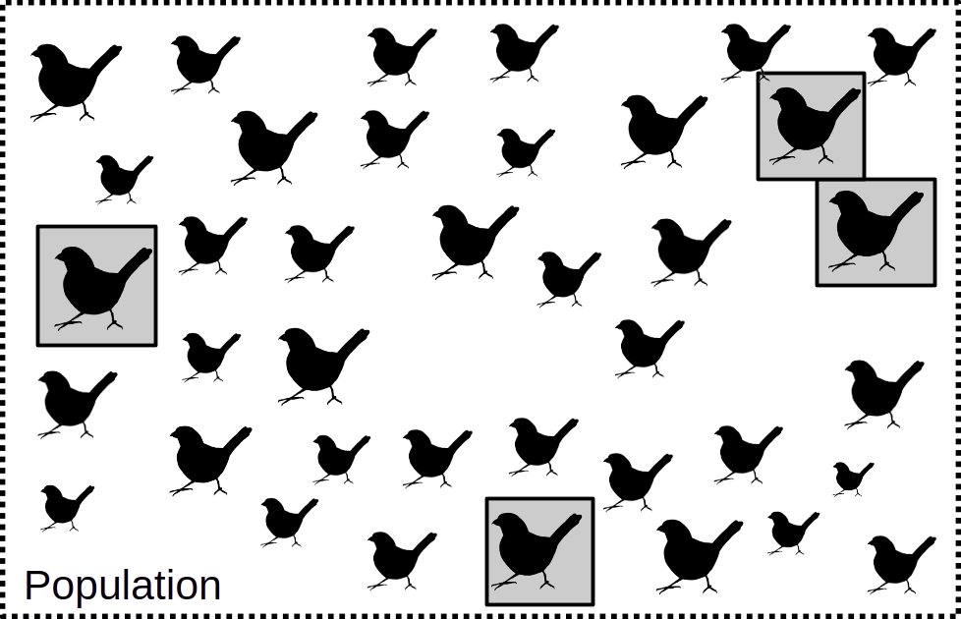
Bias and unrepresentative sample

Slide 21
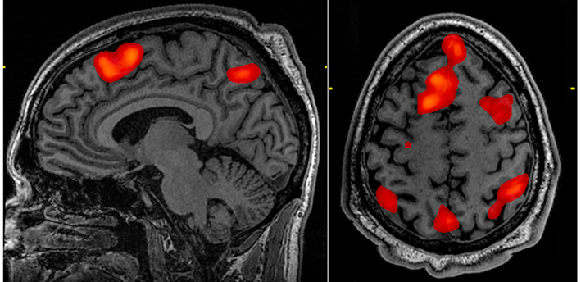
Bias and unrepresentative sample
Neuroscience: fMRI scans before & after task
What parts of brain most active during task?
Compare thousands of areas of the brain
Subject shown pictures of human social activity
Cluster of brain areas showed high activity
Typical analysis approach highly significant
Reinhart, A. 2015. Statistics done wrong: The woefully complete guide. No starch press.
Image: Graner, J. 2010. (Public domain).

Slide 22
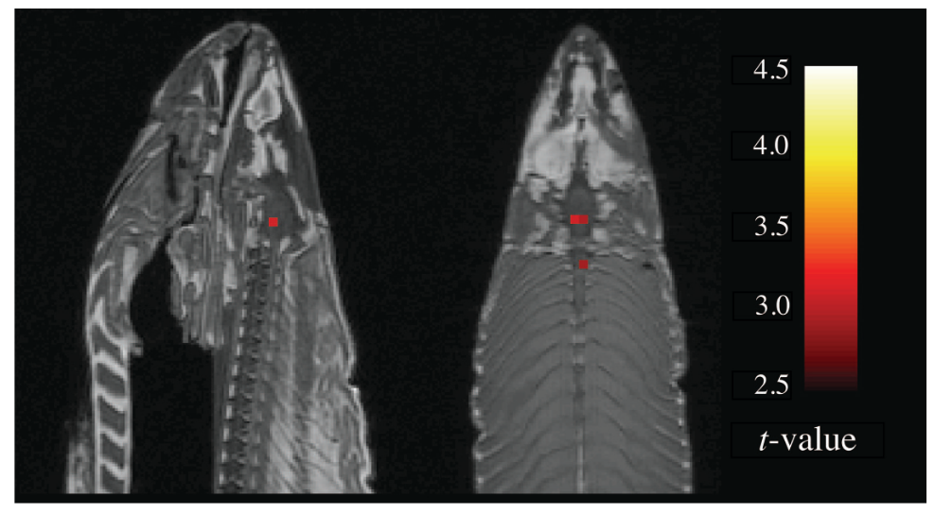
Bias and unrepresentative sample
207 different analysis methods in 241 fMRI studies
Reinhart, A. 2015. Statistics done wrong: The woefully complete guide. No starch press.
Bennett, CM, et al. 2010. J of Serendipitous and Unexpected Results. 1:1-5.
Carp, J. 2012. The secret lives of experiments: methods reporting in the fMRI literature. Neuroimage, 63:289-300. 10.1016/j.neuroimage.2012.07.004

Slide 23
Predicting one variable from another
Dependent variable
Response variable
Shown on Y axis
Independent variable
Explanatory variable
Shown on X axis

Slide 24
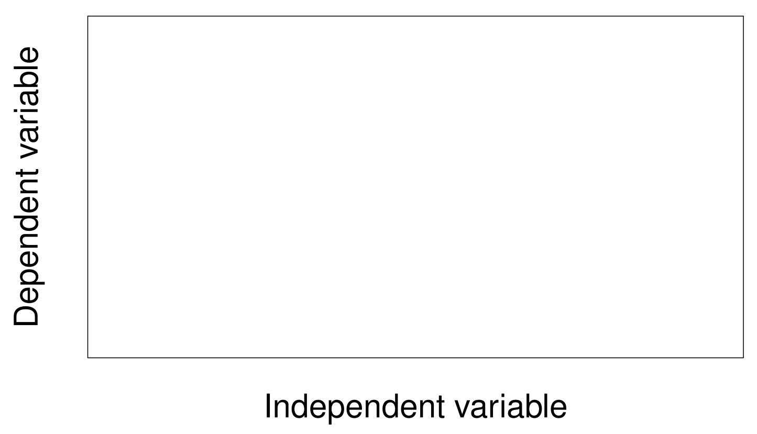
Predicting one variable from another
Figure 2: Dependent variable on the vertical (Y) axis, and independent variable on the horizontal (X) axis.

Slide 25
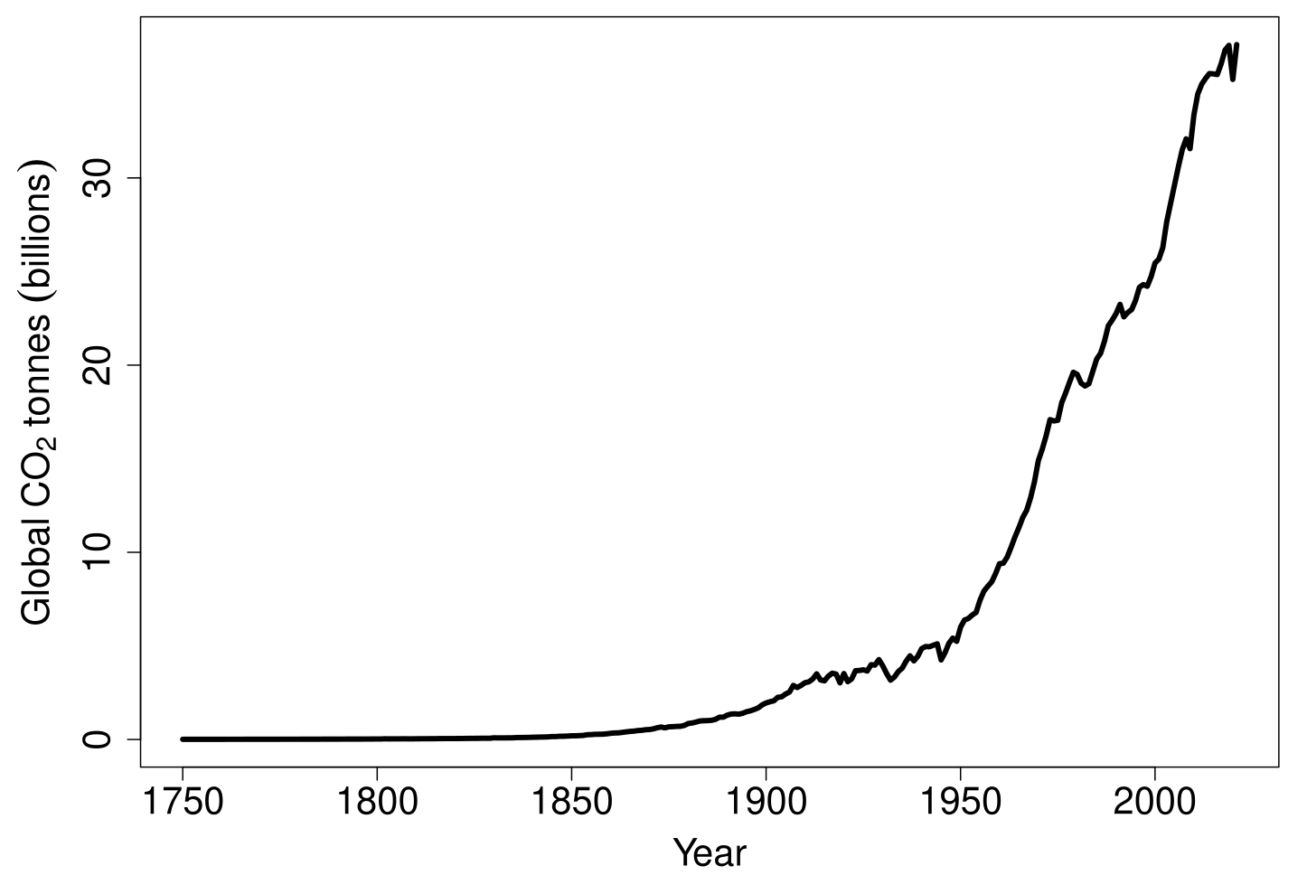
Predicting one variable from another

Slide 26
Types of variables: definitions
Categorical: Fixed number of options
Nominal: No inherent order
Ordinal: Inherent order
Quantitative: Numbers are meaningful
Discrete: Limited number of values
Continuous: Any real number

Slide 27
Types of variables: definitions
Categorical: Fixed number of options
Nominal: Tundra, Boreal, Tropical
Ordinal: Disagree, Neutral, Agree
Quantitative: Numbers are meaningful
Discrete: Numbers of offspring
Continuous: Body mass

Slide 28
Types of variables: fig wasps collected from fruit
Species | Fruit | Count | Fruit length (mm)
Het1 | F1 | 0 | 15
Het1 | F2 | 0 | 14
Het1 | F3 | 0 | 16
Het1 | F4 | 1 | 15
Het1 | F5 | 0 | 14
Het2 | F1 | 0 | 15
Het2 | F2 | 2 | 14
Het2 | F3 | 3 | 16

Slide 29
Types of variables: implications
Different variables handled in different ways
Need to use the right plot or test for a variable type

