Slide 1
Populations, variables, units, uncertainty

Slide 2
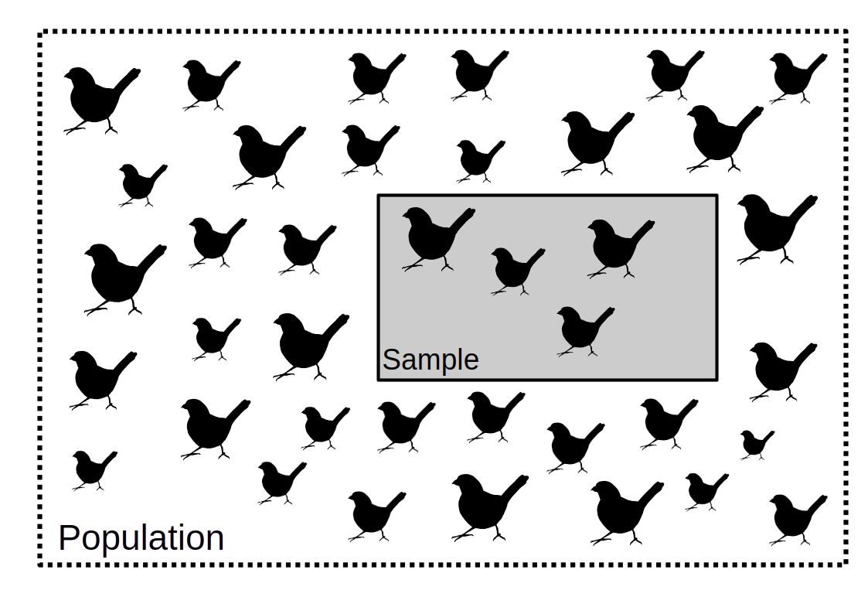
Populations and samples

Slide 3
Types of variables: definitions
Categorical: Fixed number of options
Nominal: No inherent order
Ordinal: Inherent order
Quantitative: Numbers are meaningful
Discrete: Limited number of values
Continuous: Any real number
All of these measurements have uncertainty

Slide 4
Metrology: The science of measurement
Metrology focuses on measurement accuracy, precision, and units¹
Measurement: Determination of the properties of a unit of observation
Measurand: The unknown true value of what want to measure
Measurement error: Difference between the measurement and the measurand
Rabinovich, SG. 2013. Evaluating Measurement Accuracy: A Practical Approach. Springer Science & Business Media. 10.1007/978-3-319-60125-0

Slide 5
Metrology: The science of measurement
Metrology originally for economic activities¹
Need standardised measurements for trade
Standardised to a measurement unit:
Unit of length (e.g., cm)
Unit of mass (e.g., mg)
Unit of time (e.g., seconds)
The 'unit' defines what is 1
Fanton, JP. 2019. International Journal of Metrology and Quality Engineering. 10:5.

Slide 6
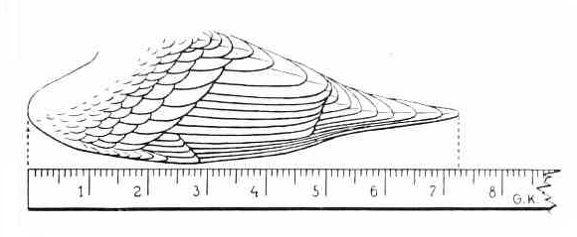
Metrology: The science of measurement
Measuring wing length in centimetres (cm)
Measure 7.28 units of length (cm)
Measurand is the true wing length
Repeated measures estimate error
Fanton, JP. 2019. International Journal of Metrology and Quality Engineering. 10:5.

Slide 7
Accuracy and precision
Accuracy is how close a measurement is to the true value we want to measure.¹
Precision is how consistent a measurement will be if replicated multiple times.²
Rabinovich, SG. 2013. Evaluating Measurement Accuracy: A Practical Approach. Springer Science & Business Media. 10.1007/978-3-319-60125-0
Wardlaw, AC. 1985. Practical Statistics for Experimental Biologists (p. 290). John Wiley & Sons, Chichester, UK.

Slide 8
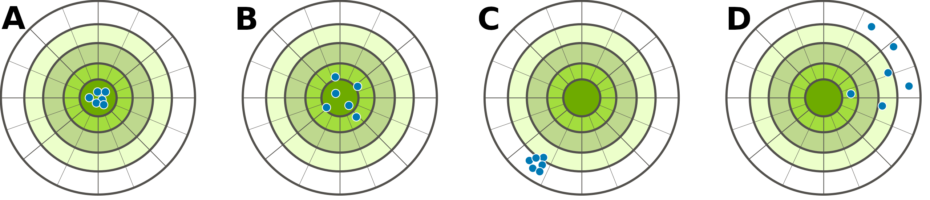
Accuracy and precision
Measurement can be as follows:
A: Accurate and precise
B: Accurate but not precise
C: Not accurate but precise
D: Not accurate nor precise
Image: Willighagen, E. 2014. (Public domain).

Slide 9
Units of measurement
Units of measurement different from units of observation
Measurement unit is a defined measurement quantity
Standardised units of measurement ensure accuracy¹
Ideally based on fundamental constants of nature²
Measurement units can be base or derived
Seven standardised base units
Quinn, TJ. 1995. Metrologia, 31:515–527. 10.1088/0026-1394/31/6/011
Stock, M, et al. 2019. Metrologia, 56:022001

Slide 10
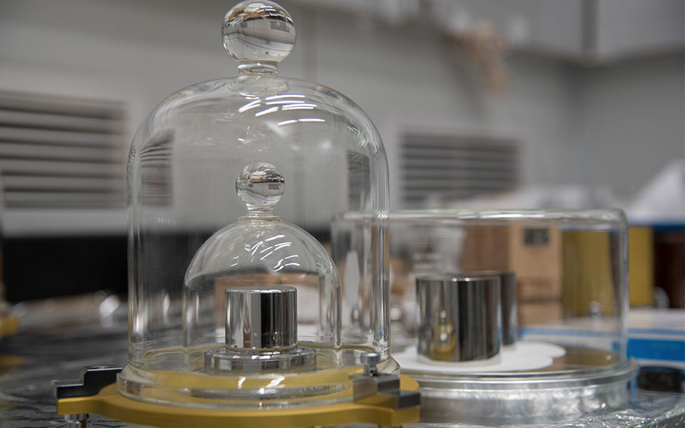
Kilogram was defined by a mass of metal
Image: National Inst. of Standards & Technology. 2021. (Public domain).

Slide 11
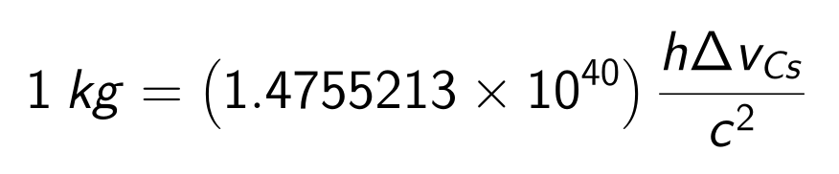
Kilogram was defined by a mass of metal
Standardising mass to a physical object problematic
If object changes, so does the unit of mass
Base unit affects all other measurements
Kilogram redefined in 2019¹:
Atomic transition frequency (ΔvCs )
Speed of light (c)
Planck constant (h)
Stock, M, et al. 2019. Metrologia, 56:022001

Slide 12
Base units of SI measurements
Measured Quantity | Name of SI Unit | Symbol
Mass | kilogram | kg
Length | metre | m
Time | second | s
Electric current | ampere | A
Temperature | kelvin | K
Amount of a substance | mole | mol
Luminous intensity | candela | cd

Slide 13
Derived SI measurements
Measured Quantity | Name of SI Unit | Symbol | Definition in SI Units
Area | square metre | A | m²
Volume | cubic metre | V | m³
Speed | metre per second | v | m s⁻¹
Force | newton | N | m kg s⁻²
Pressure | pascal | Pa | m⁻¹ kg s⁻²
Energy | joule | J | m² kg s⁻²
Derived units of measurement built from base units

Slide 14
Units versus labels
Unit defines a magnitude of a quantity
1 kilogram
1 metre
Label describes the data type
soil mass
flight distance
Counts do not have units
20 glaciers
800 seeds

Slide 15
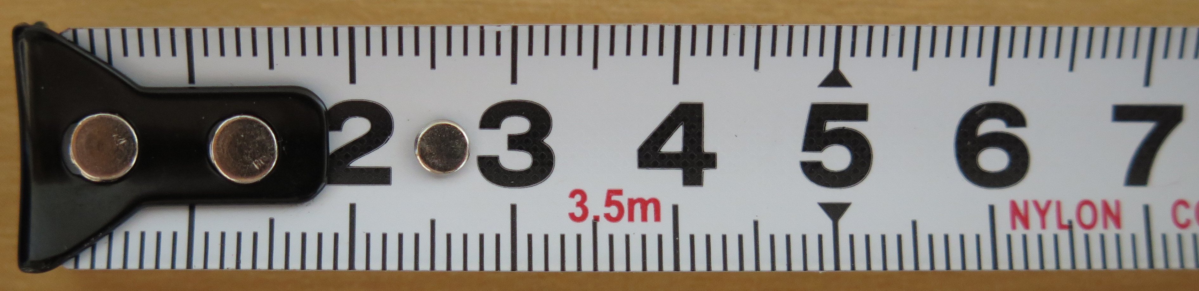
Measurement uncertainty propagation
Nothing measured with perfect accuracy
Noise in the measuring environment
Mistakes made in measurement
Limitations of measuring device
Measurement errors accumulate!
Image: Perkins, D. 2015. (Public domain).

Slide 16
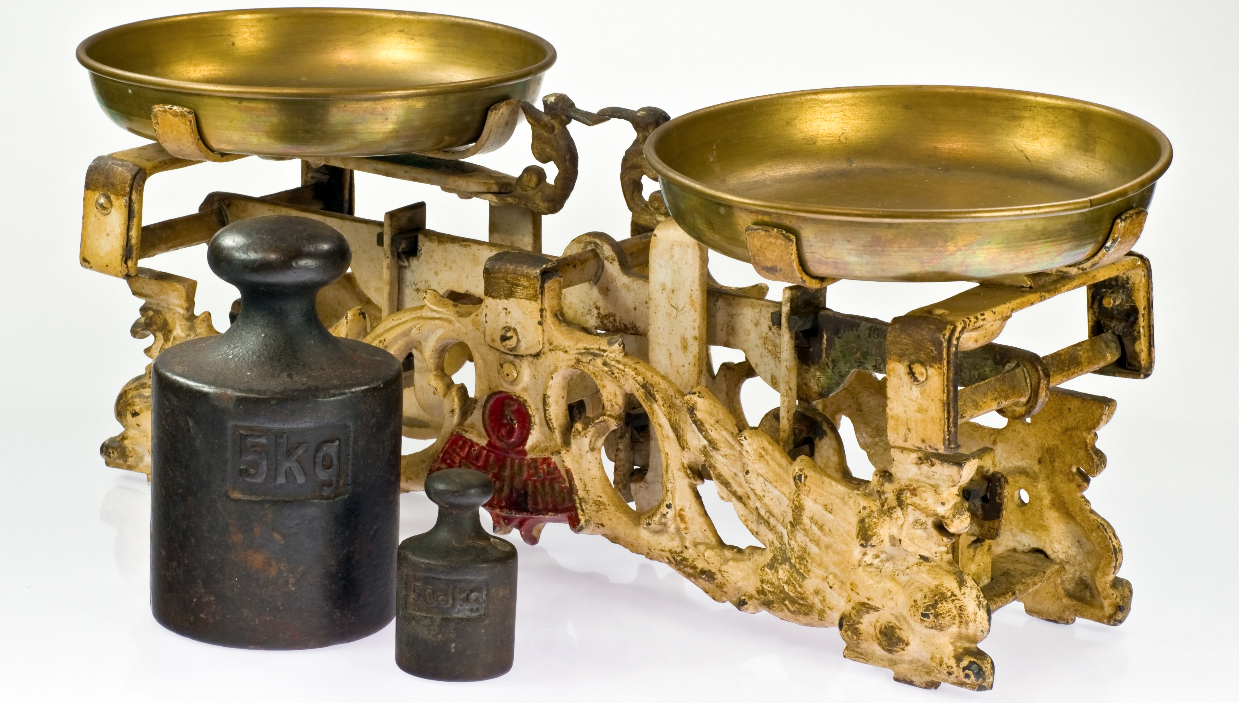
Measurement uncertainty propagation
Suppose we measured 2 stones separately
Each measurement has a ± error
Image: Nijaki, N. 2011. (Public domain).

Slide 17
Measurement uncertainty propagation
Combined measurement error
Stone 1: 40 ± 1.2 kg
Stone 2: 36 ± 1.1 kg
Combined mass:
40 kg + 36 kg = 76 kg
Combined measurement error?

Slide 18
Measurement uncertainty propagation
Stone example:
Combined mass = Mass 1 + Mass 2
More generally:
Z = X + Y
With error (E):
(Z ± E_{Z}) = (X ± E_{X}) + (Y ± E_{Y})

Slide 19
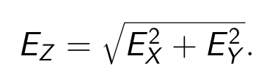

Measurement uncertainty propagation
(Z ± E_{Z}) = (X ± E_{X}) + (Y ± E_{Y})
If we solve for EZ,
For our two stones,

Slide 20
Measurement uncertainty propagation
Morning run: 4.5 ± 0.3 km
Evening run: 3.8 ± 0.2 km
Combined error (E_{Z}) for total run length?

Slide 21

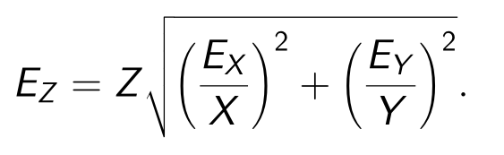
Measurement uncertainty propagation
Z = X × Y
Combining errors different for multiplication
If we isolate E_{Z},

Slide 22
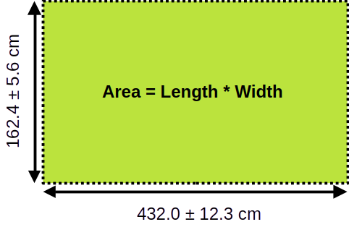
Measurement uncertainty propagation

Slide 23
Calculating uncertainty
X = 432
Y = 162
E_{X} = 12.3
E_{Y} = 5.6

Slide 24
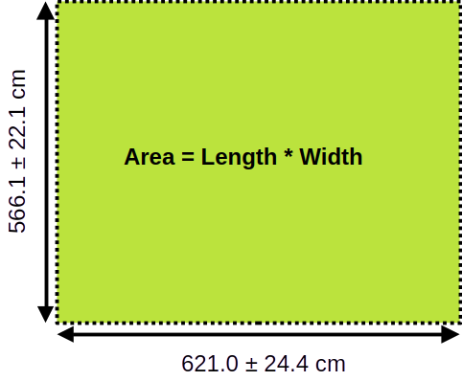
Measurement uncertainty propagation

Slide 25
Calculating uncertainty

Slide 26
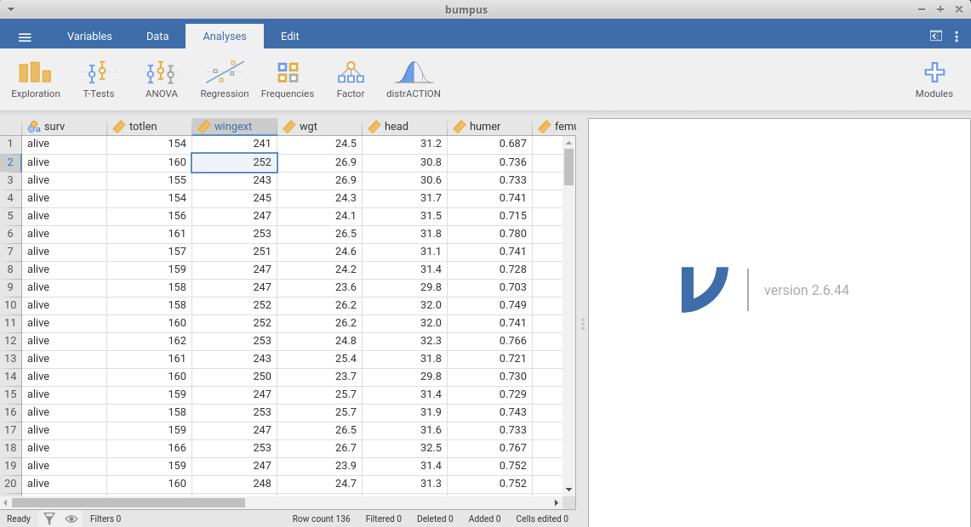
Working with jamovi

Slide 27
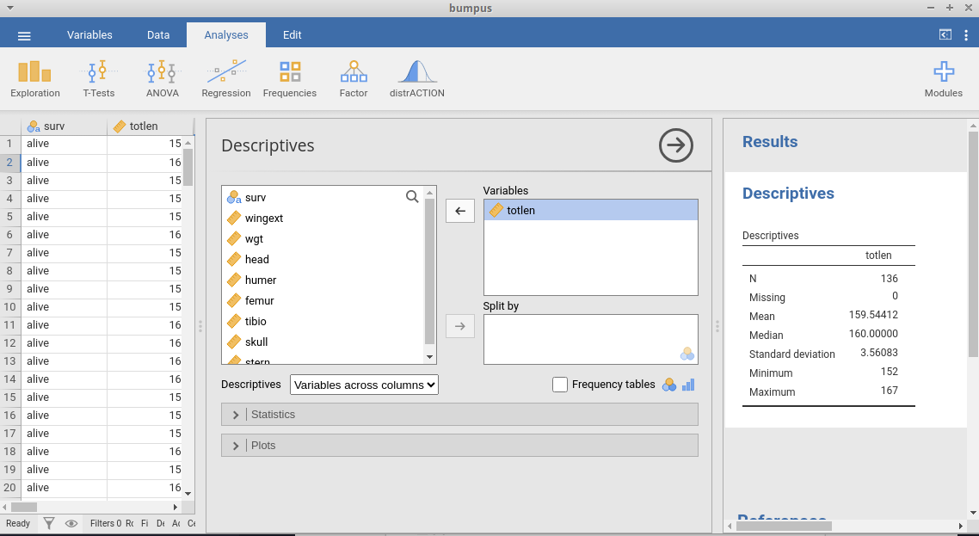
Working with jamovi

Slide 28
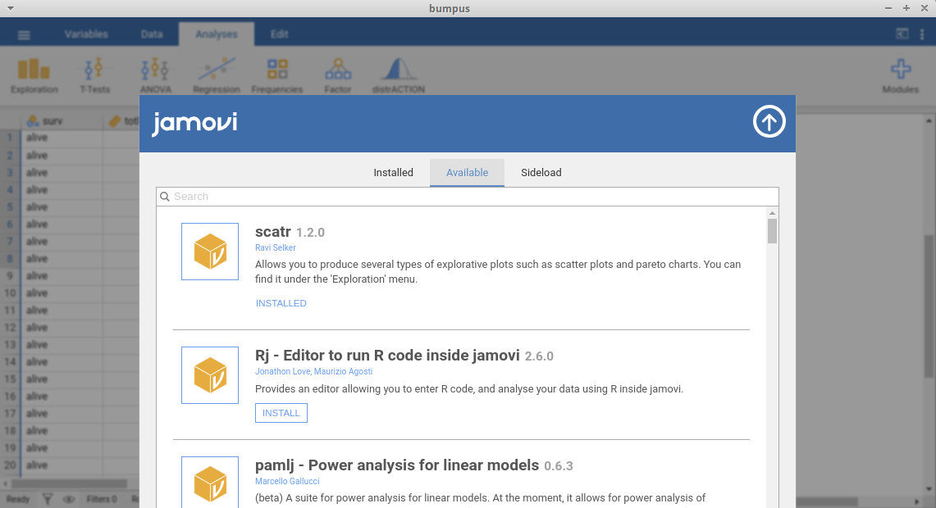
Working with jamovi

