Slide 1
Probability and Distributions

Slide 2
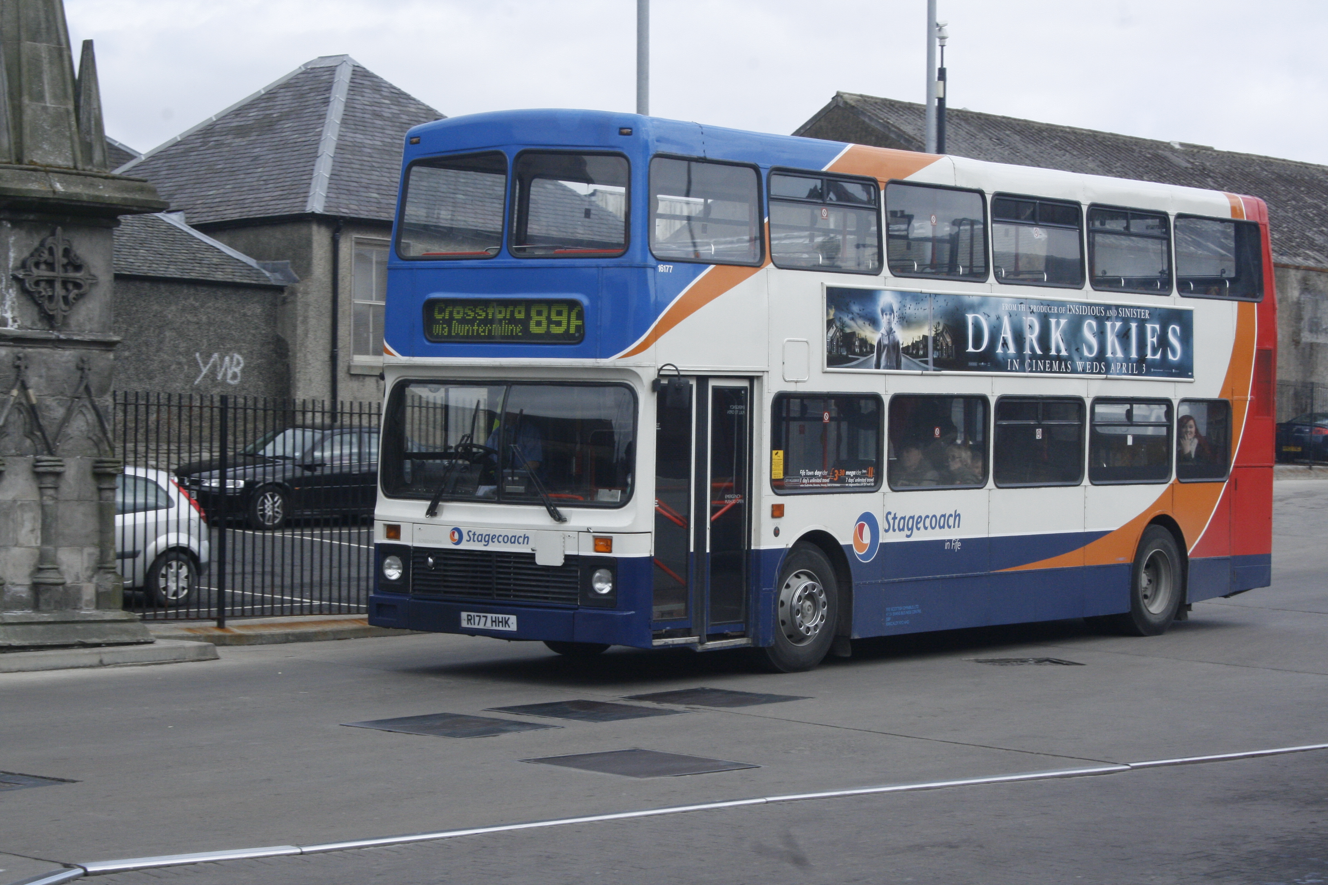
Probability: How likely is something to happen?
Image: Smith, C. 2013 (Public domain)

Slide 3
Frequentist interpretation of probability
How frequently was the bus late after 120 morning rides?
Late: 24 times
Note late: 96: times
Given these observation frequencies, predict the probability that it will be late on any given morning.

Slide 4
Frequentist interpretation of probability
How frequently was the bus late after 120 morning rides?
Late: 24 times
Note late: 96: times
Probability is the long-term relative frequency
Pr(Late) = 24 / (24+96) = 24/120 = 0.2

Slide 5
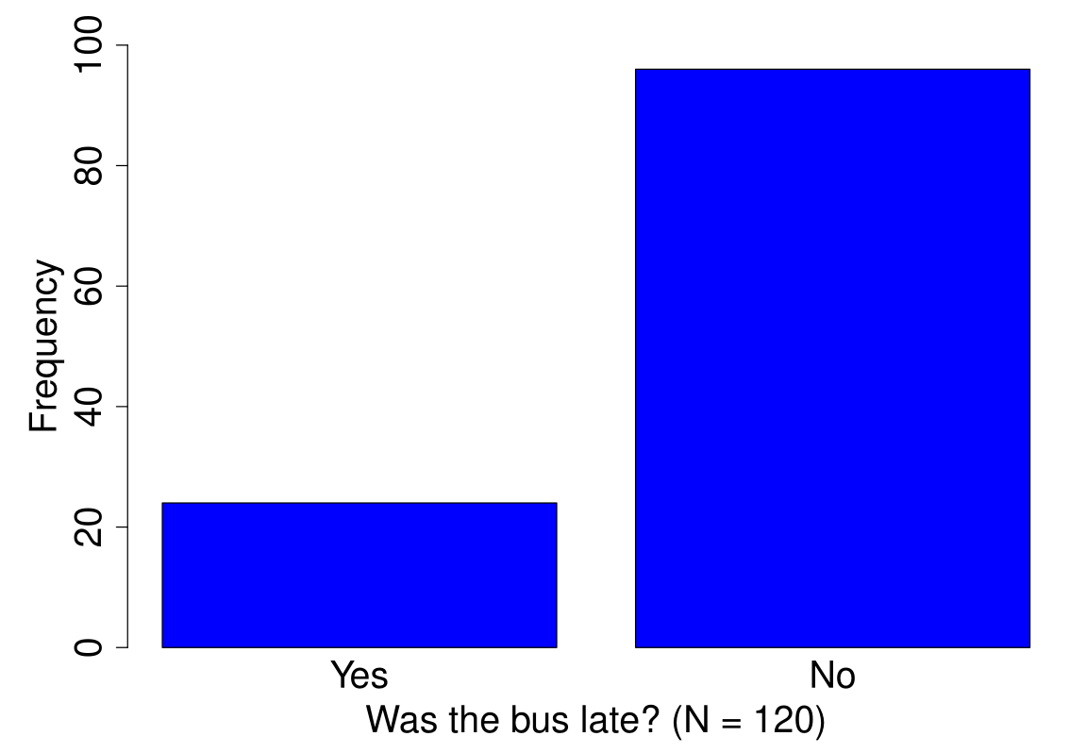
Frequentist interpretation of probability

Slide 6
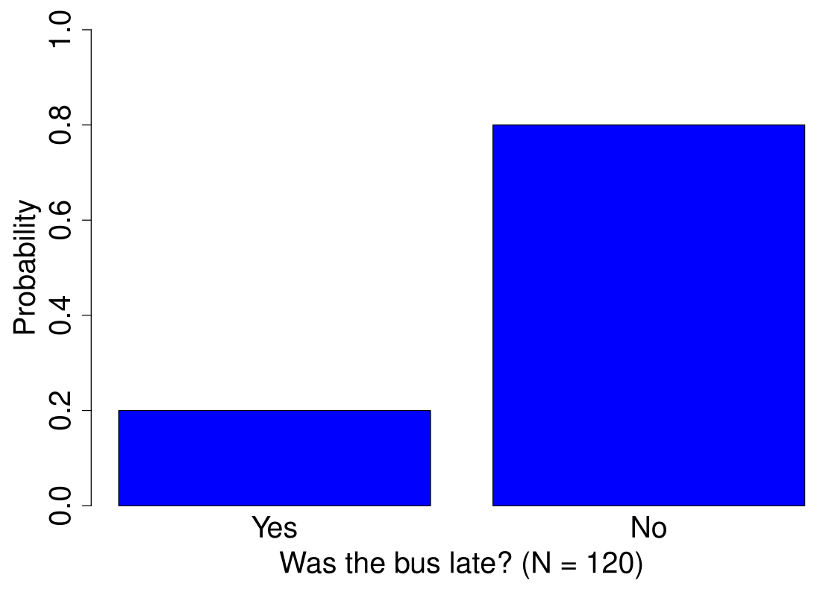
Frequentist interpretation of probability

Slide 7
Frequentist interpretation of probability
How frequently was the bus late after 120 morning rides?
Late: 24 times -> Pr(Late) = 0.2
Note late: 96 times -> Pr(Not late) = 0.8
Values must sum to 1:
Pr(Event) = 0: An event never occurs
Pr(Event) = 1: An event always occurs

Slide 8
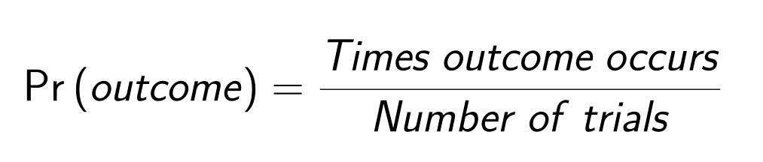
Frequentist interpretation of probability
How frequently was the bus late after 120 morning rides?
Late: 24 times -> Pr(Late) = 0.2
Note late: 96 times -> Pr(Not late) = 0.8

Slide 9
Importance in life and environmental sciences
What can we predict?
Extreme climate events
Genotypes of offspring
Risk of disease spread
Population extinction
Outcomes in games

Slide 10
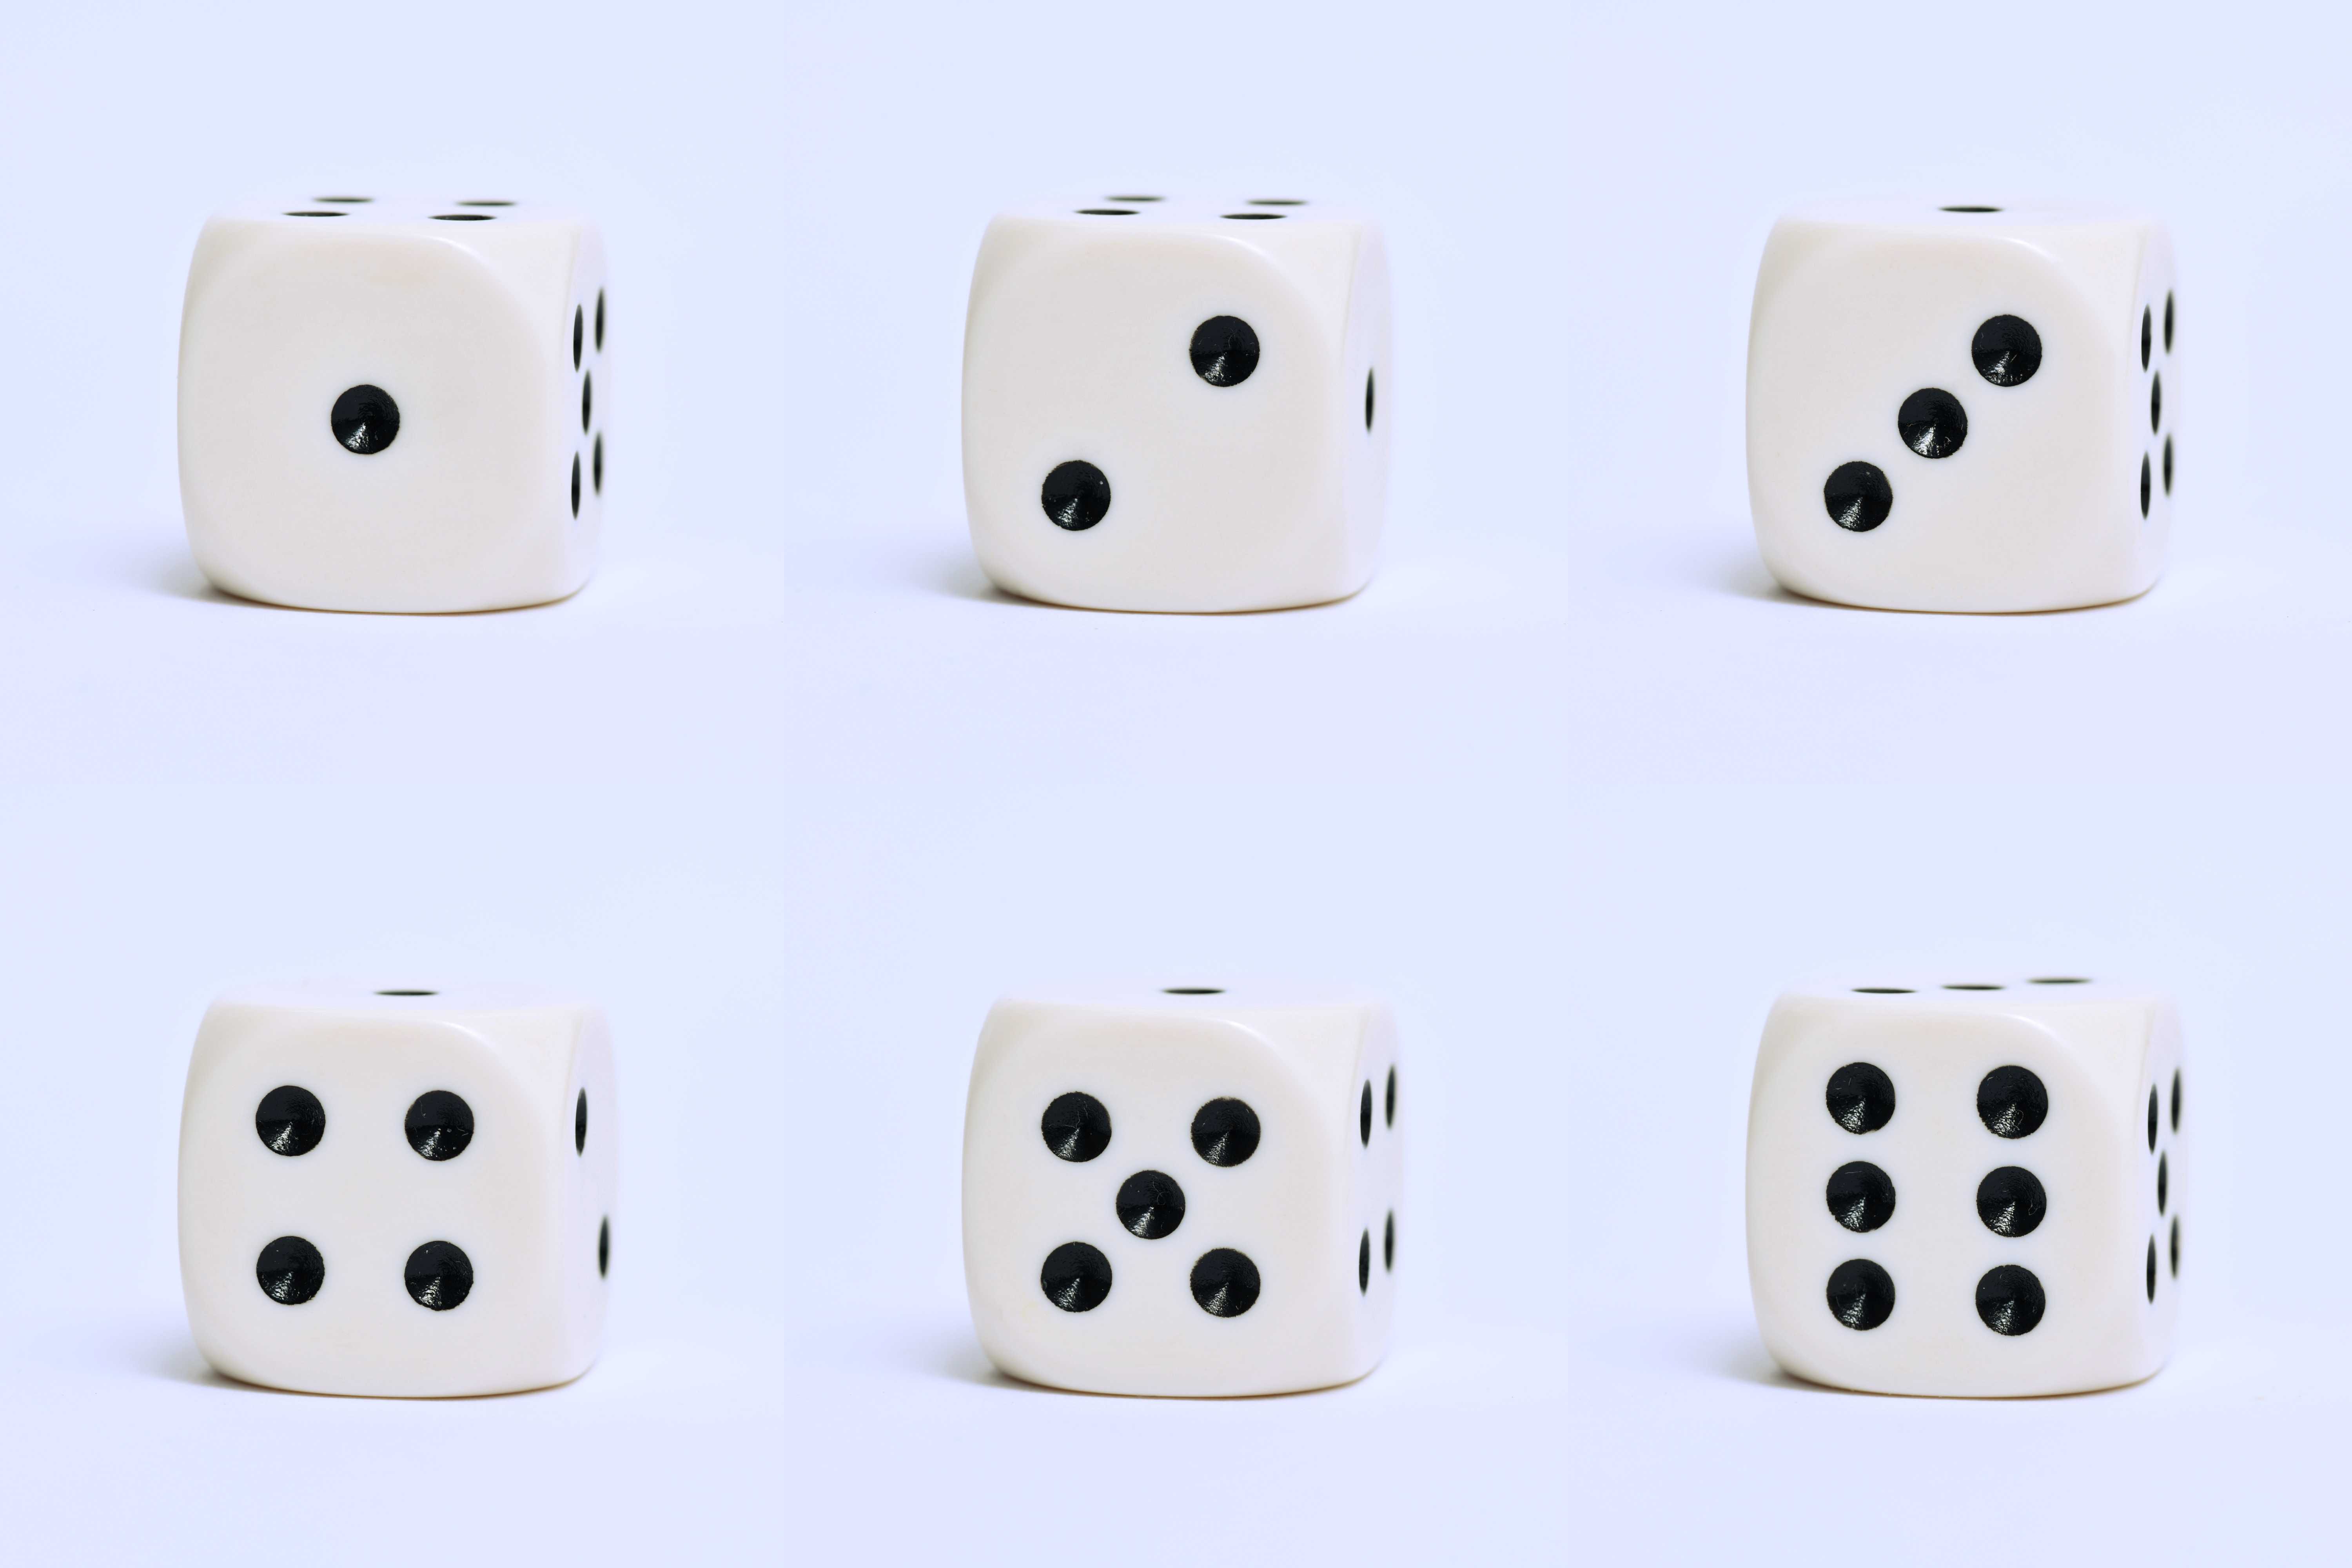
Games of chance: Probability is a key component
Image: Korsalka, Z. 2021. (Public domain).

Slide 11
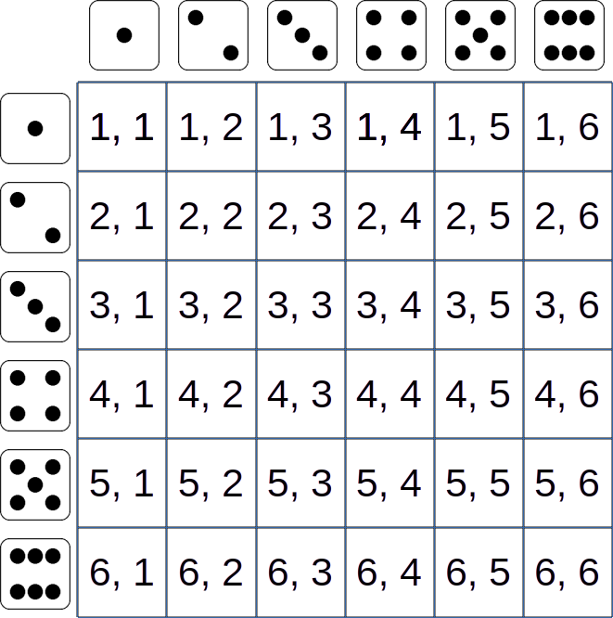
Rolling two dice; what can happen?
Image: All dice images are public domain

Slide 12
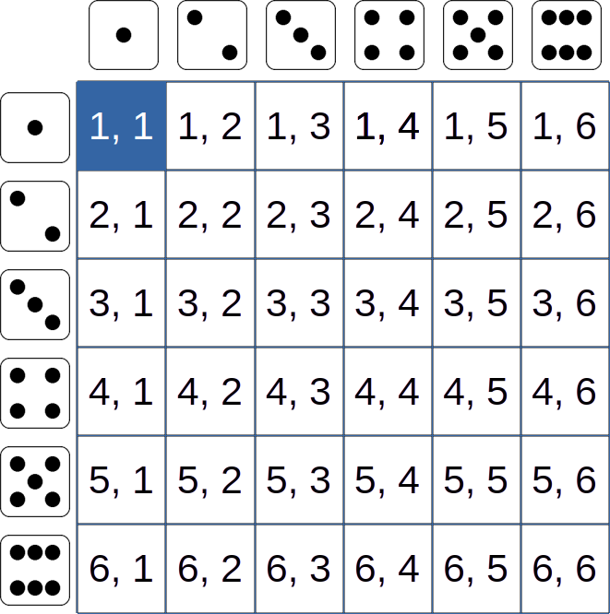
Probability of rolling two 1s
Pr(Dice₁ = 1 & Dice₂ = 1) = 1/36 = 0.0278
Image: All dice images are public domain

Slide 13
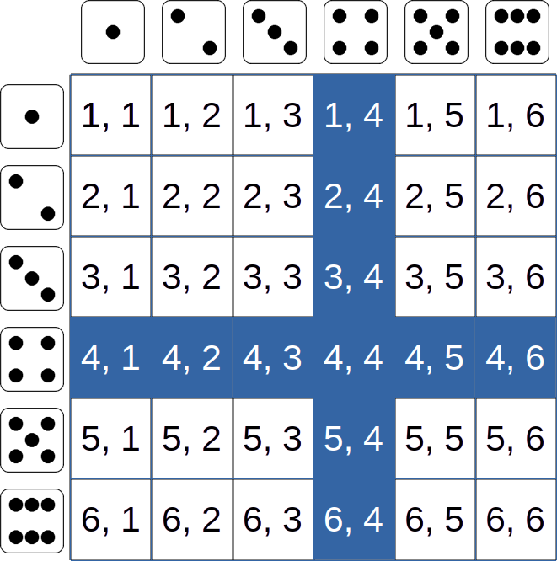
Probability of rolling at least one 4
Pr(a four) = 11/36 = 0.3056
Image: All dice images are public domain

Slide 14
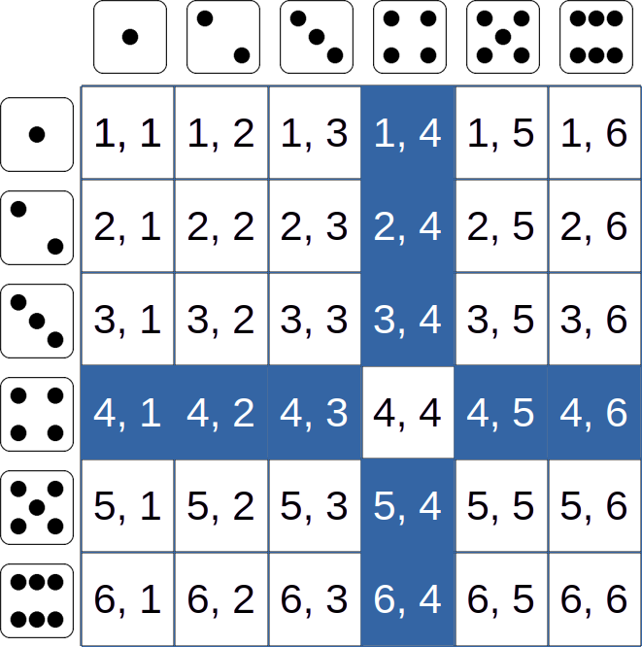
Probability of rolling exactly one 4
Pr(exactly one four) = 10/36 = 0.2778
Image: All dice images are public domain

Slide 15
Adding or multiplying probabilities
Mutually exclusive: Events cannot happen simultaneously
Cannot roll 2 values with one dice
You can roll a 1 or a 2, not both
Not mutually exclusive: Events can happen simultaneously
Can roll 2 values with two dice
You can roll a 1 and another 1

Slide 16
Adding or multiplying probabilities
Mutually exclusive: Events cannot happen simultaneously
Roll a 1 or a 2 with one dice
Pr(Roll = 1 or Roll = 2)
Pr(Roll = 1) + Pr(Roll = 2)
Pr(one or two) = 1/6 + 1/6 = 2/6 = 0.3333

Slide 17
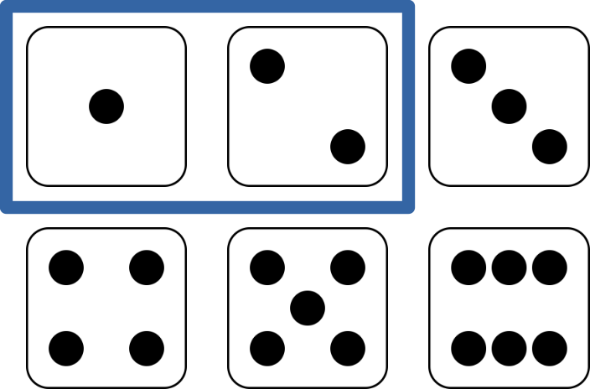
Adding or multiplying probabilities

Slide 18
Adding or multiplying probabilities
Add probabilities when events are mutually exclusive
Multiply probabilities when events are not mutually exclusive

Slide 19
Adding or multiplying probabilities
Not mutually exclusive: Events can happen simultaneously
Can roll 2 values with two dice
You can roll a 1 and another 1
Pr(Roll₁ and Roll₂ = 1)
Pr(Roll₁ = 1) × Pr(Roll₂ = 1)
Pr(one and one) = 1/6 × 1/6 = 1/36 = 0.0278

Slide 20
Probability of rolling a 1 and another 1
Pr(one and one) = 1/6 × 1/6 = 1/36 = 0.0278
Image: All dice images are public domain

Slide 21
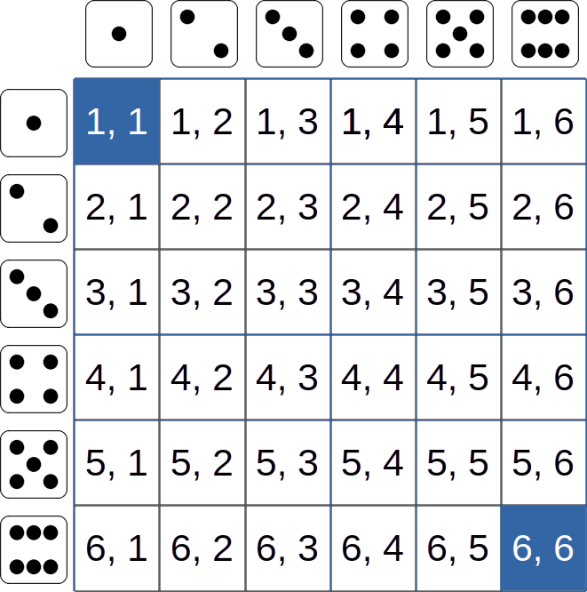
Probability of rolling two 1s or two 6s
Pr(two 1s | two 6s) = 1/36 + 1/36 = 2/36 = 0.0556
Image: All dice images are public domain

Slide 22
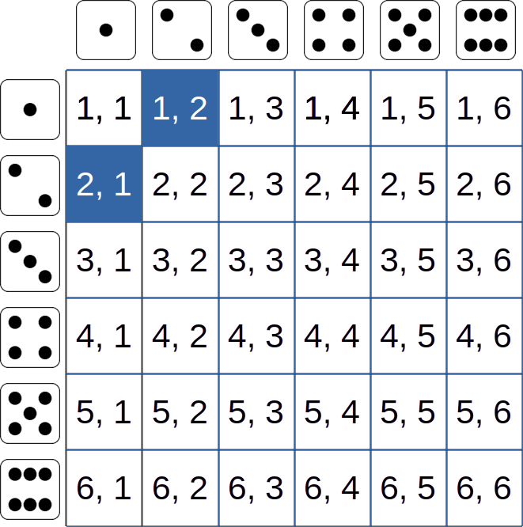
Probability of rolling a 1 and a 2
Pr(one & two) = (1/6 × 1/6) + (1/6 × 1/6) = 1/36 + 1/36 = 2/36 = 0.0556
Image: All dice images are public domain

Slide 23
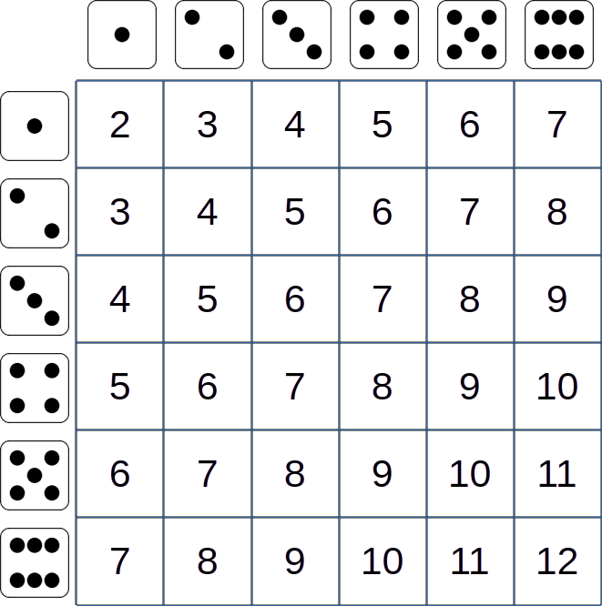
Sum of rolls; what's the distribution
Image: All dice images are public domain

Slide 24
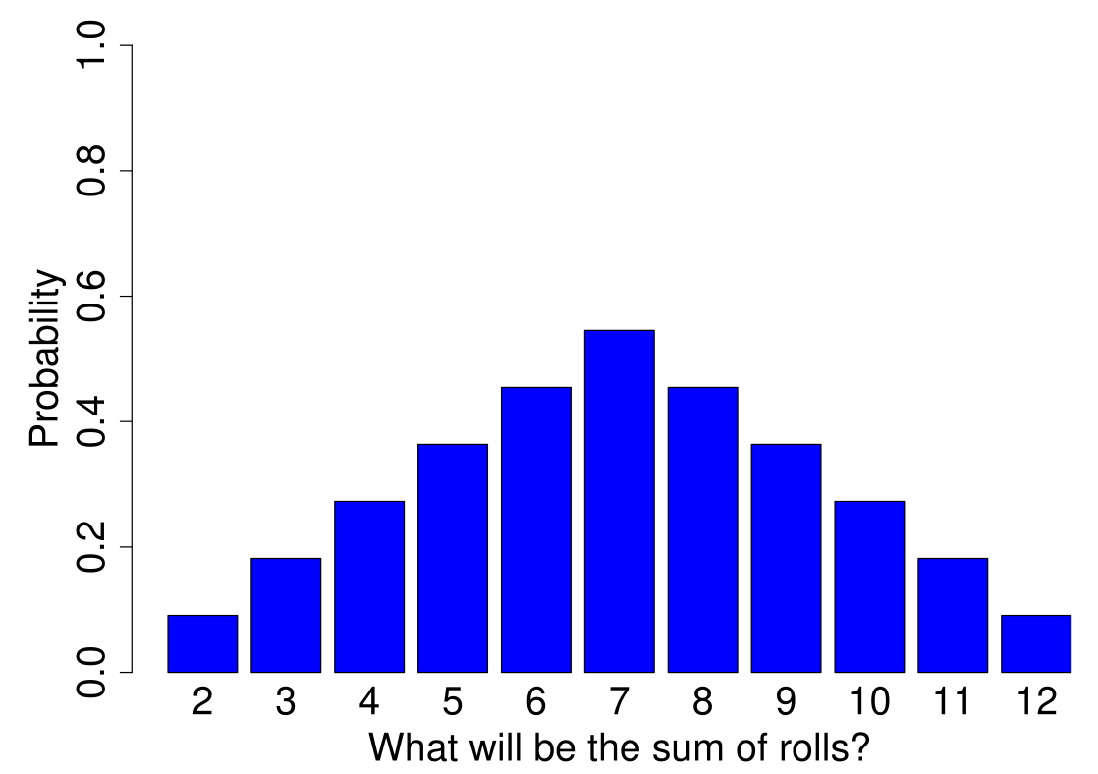
Sum of rolls; what's the distribution

Slide 25
Sampling with and without replacement
With replacement: Whatever is sampled gets put back before sampling again
Without replacement: Whatever is sampled doesn’t get put back before sampling

Slide 26
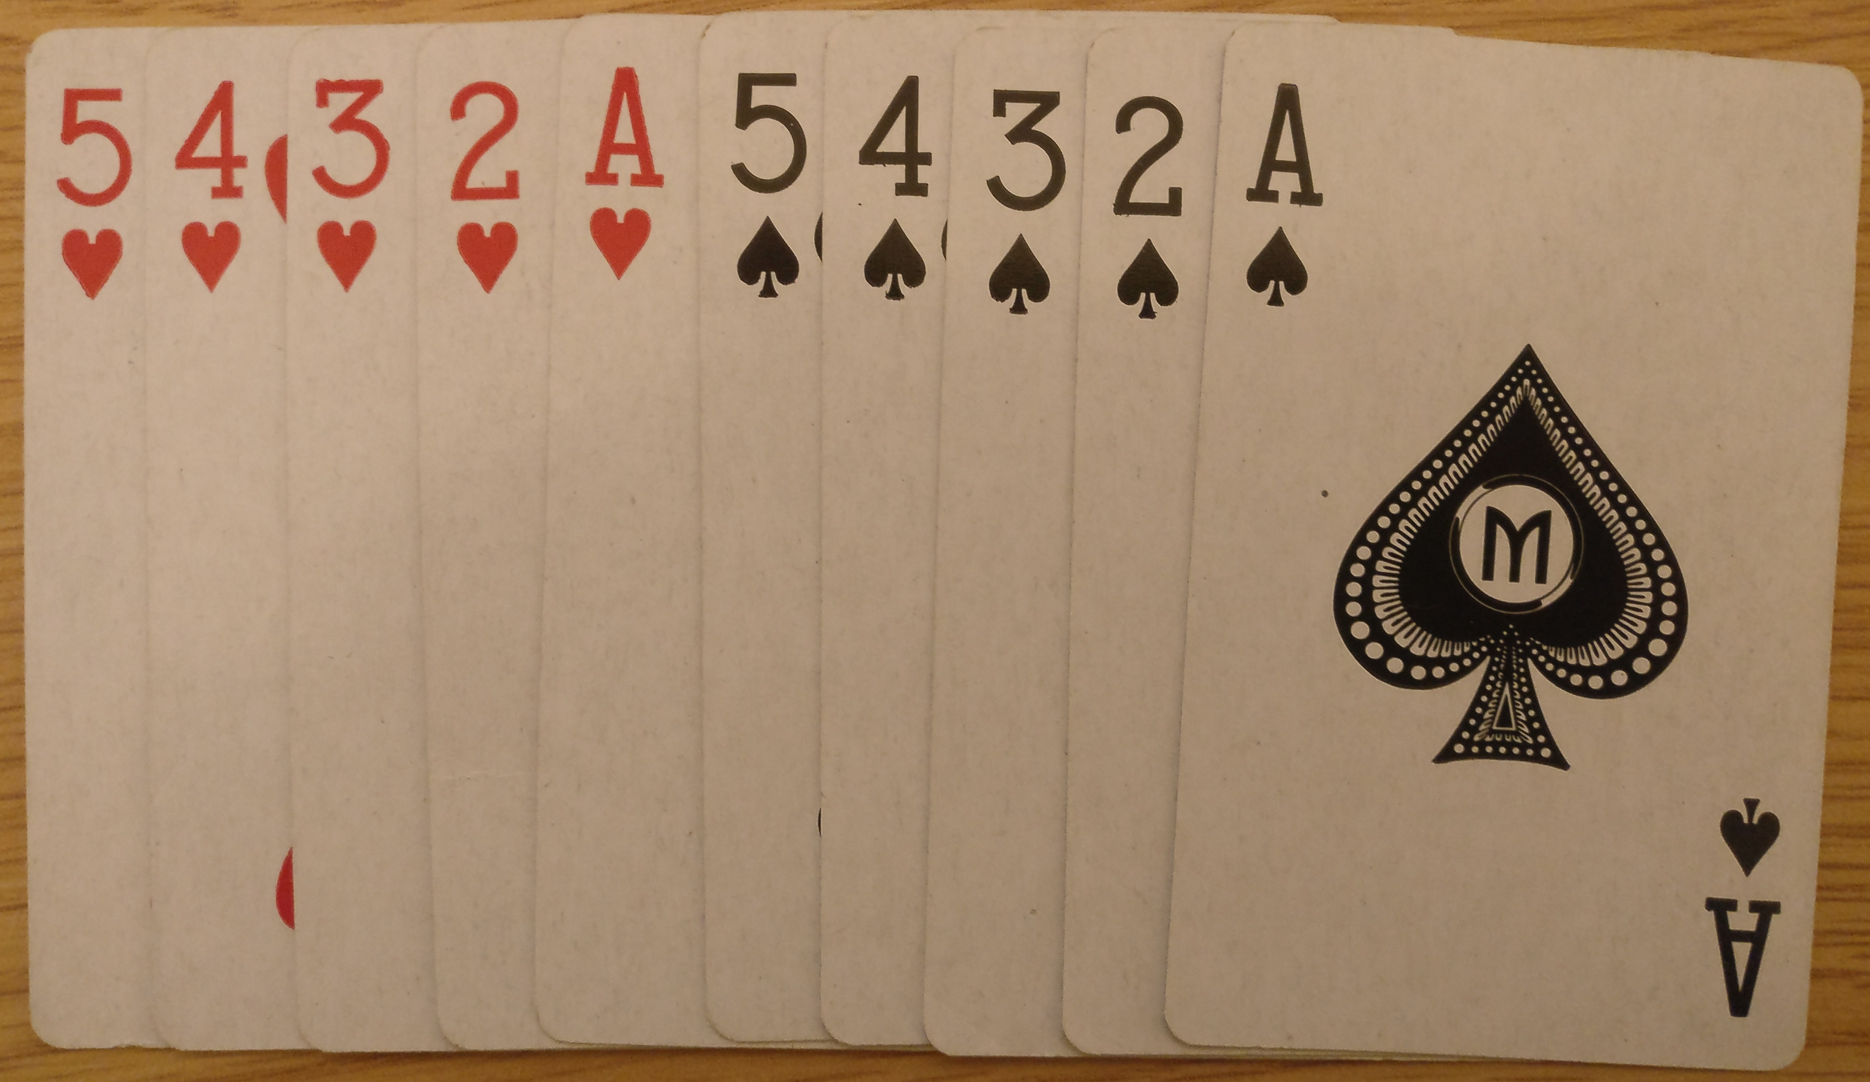
Sampling with and without replacement
Pick two cards: Probability you sample 2 aces with versus without replacement?

Slide 27
Sampling with and without replacement
With replacement:
2/10 × 2/10 = 0.04
Without replacement:
2/10 × 1/9 = 0.0222

Slide 28
Probability distributions: Binomial distribution
Event is an individual trial
Successful: Pr(X)
Unsuccessful: 1 – Pr(X)
Successes over N trials
Binomial distribution
Coin flips heads

Slide 29
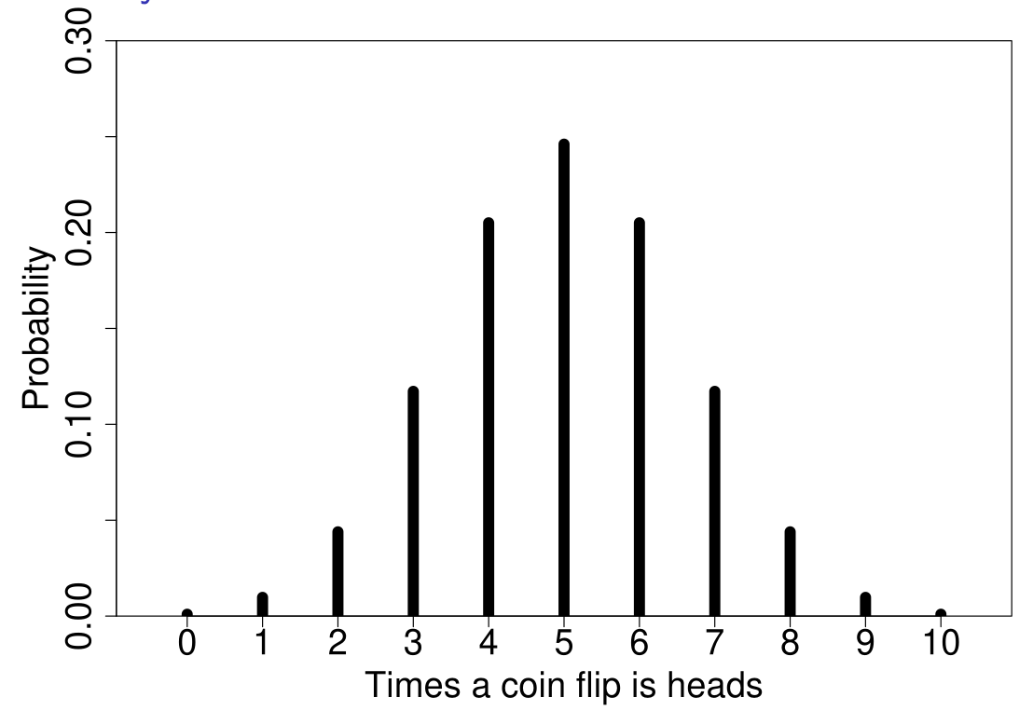
Probability distributions: Binomial distribution
Figure 1: Probability of times a coin flips heads in 10 trials

Slide 30

Probability distributions: Poisson distribution
How many observations over a period of time?
Also applies to a period of space
Image: Public domain

Slide 31
Probability distributions: Poisson distribution
How many observations over a period of time?
Suppose 2.5 herons pass per hour on average
Distribution of herons seen in one hour?
Sometimes will be more or fewer
Distribution has one parameter (rate = λ)
If we expected to see 2.5 heron, λ = 2.5
Poisson distribution applies to counts, so observations natural numbers

Slide 32
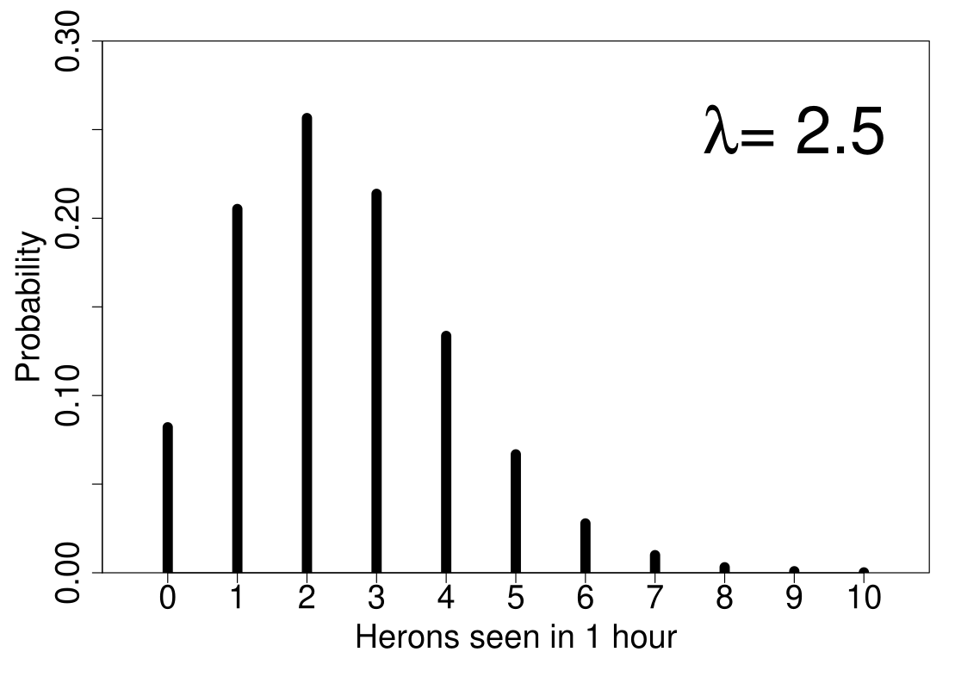
Probability distributions: Poisson distribution

Slide 33
Probability distributions: Poisson distribution
Count successes or observations
Binomial: Yes or No
Poisson: Natural number
Describe distribution with a probability mass function.

Slide 34
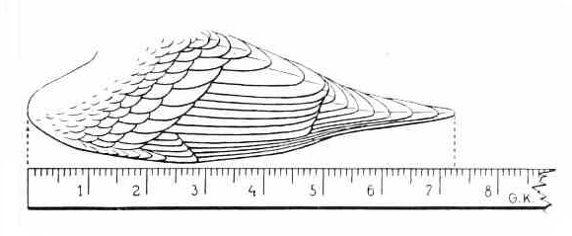
Probability for continuous values
What if an observation can take any real number?
What is the probability of measuring a wing length of 7.28 cm?
Image: Reichenow, A. 1913 (Public domain).

Slide 35
Probability for continuous values
If values are continuous, need to consider a range of values
Probability wing length between 7 and 8 cm?
Describe with a probability density function

Slide 36
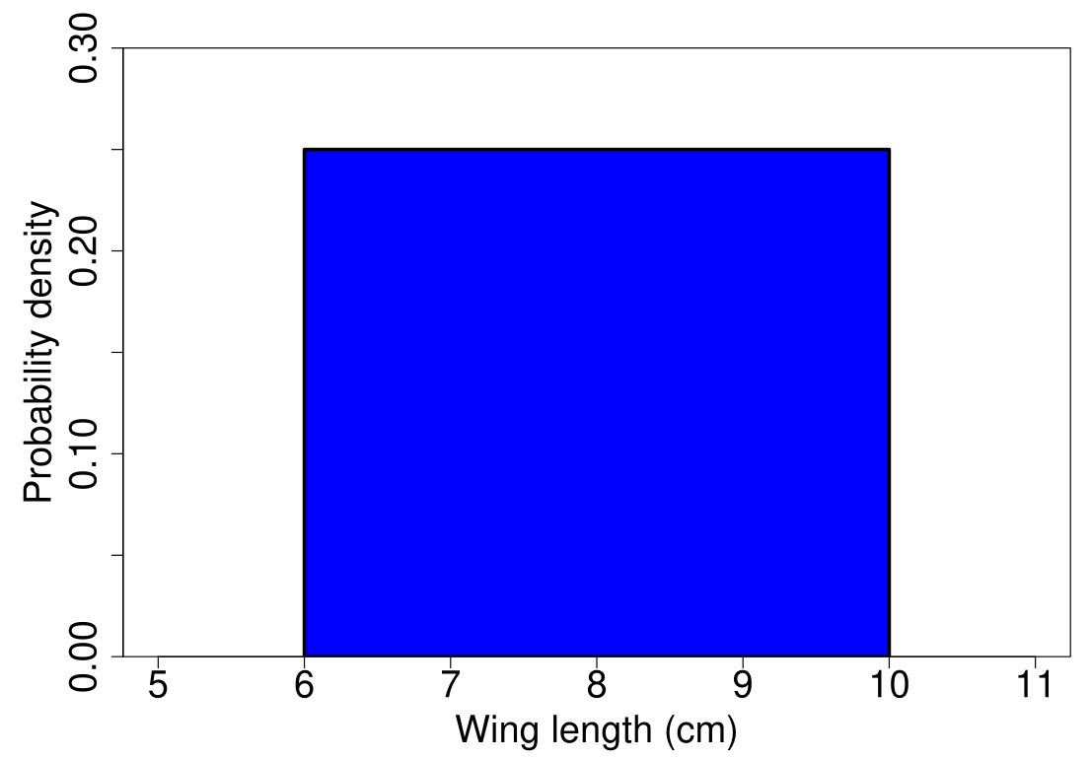
Uniform distribution (note area sums to 1)

Slide 37
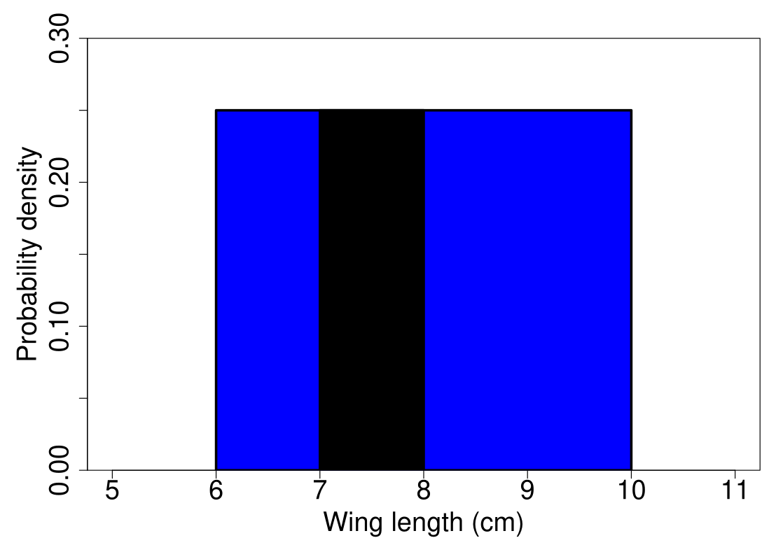
Uniform distribution (note area sums to 1)

Slide 38
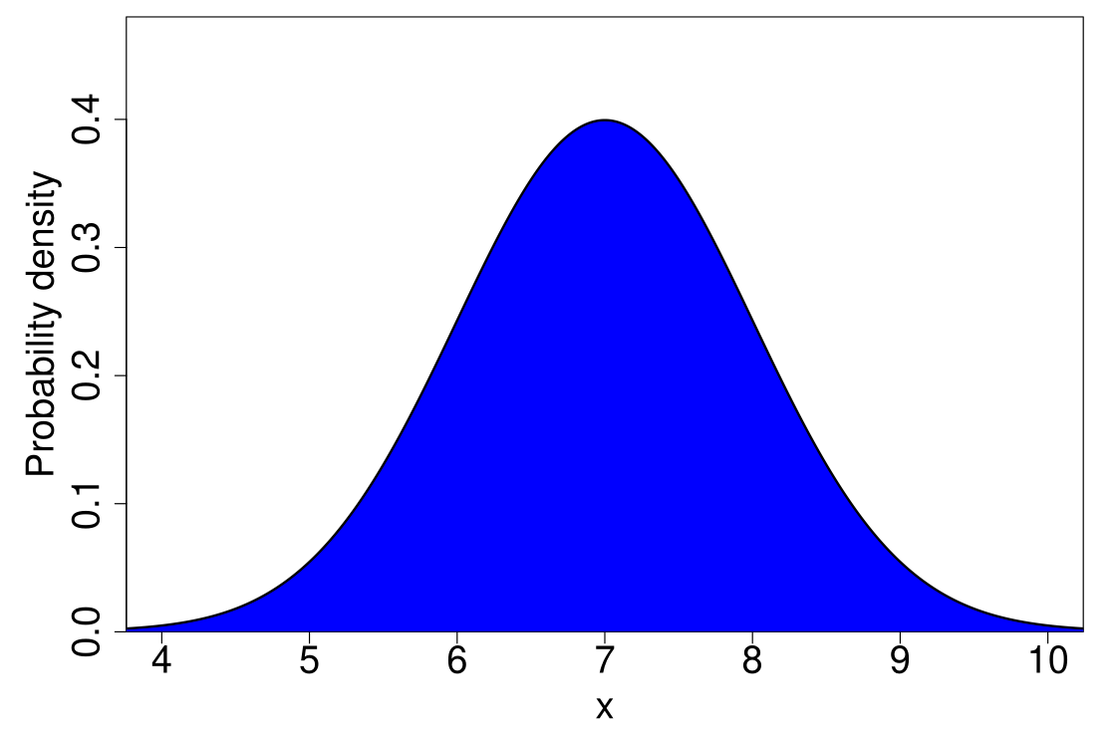
Normal distribution (area also sums to 1)

