Slide 1
z- and t-intervals

Slide 2
Confidence in sampled mean value
The goal of CIs is to contain uncertainty:
How frequently will the CIs that we draw contain the population mean (μ_{x})?
Logic is again based on repeated resampling

Slide 3
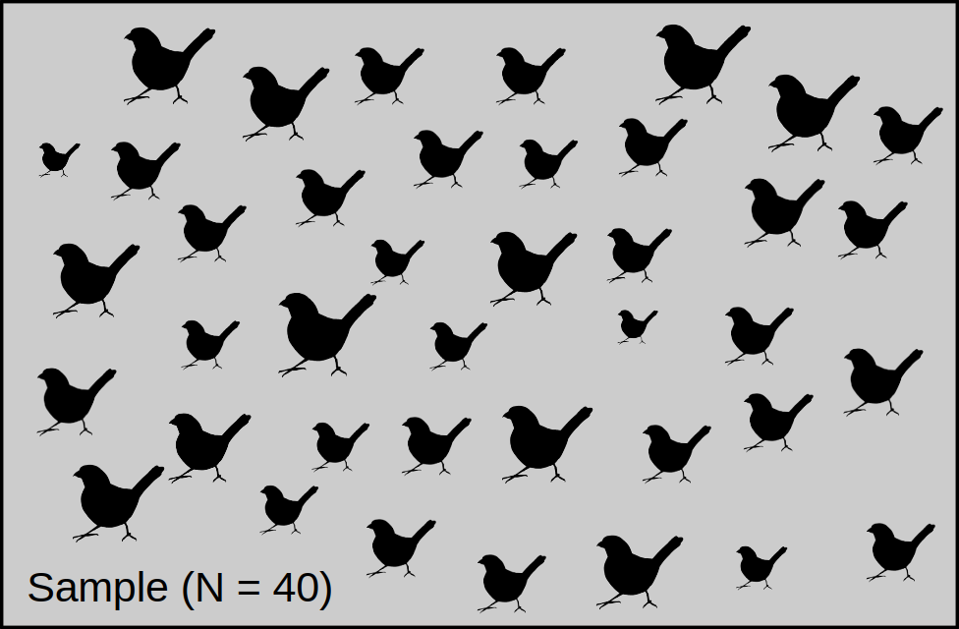
Consider the distribution of a sample of N = 40

Slide 4
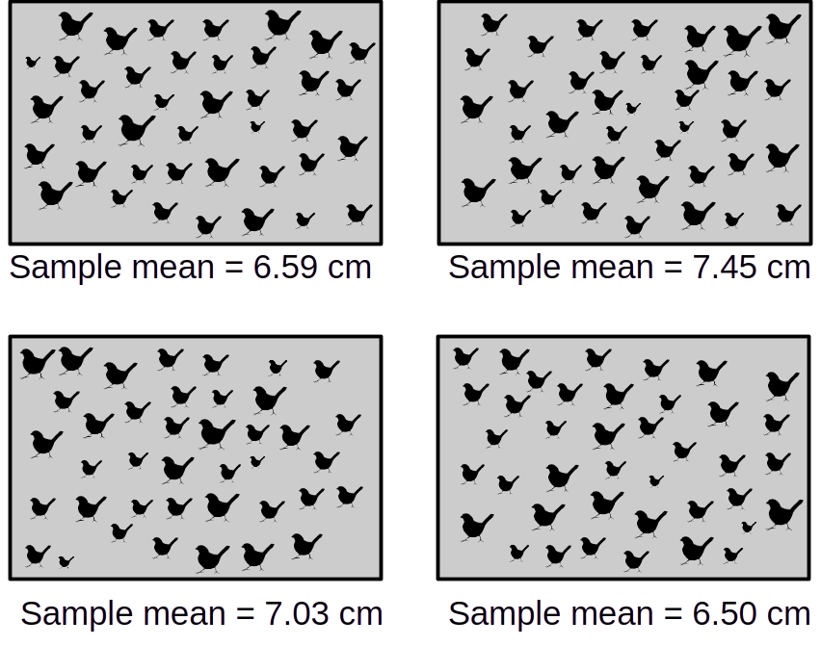
Sample means given true mean of 7.2 when N = 40

Slide 5
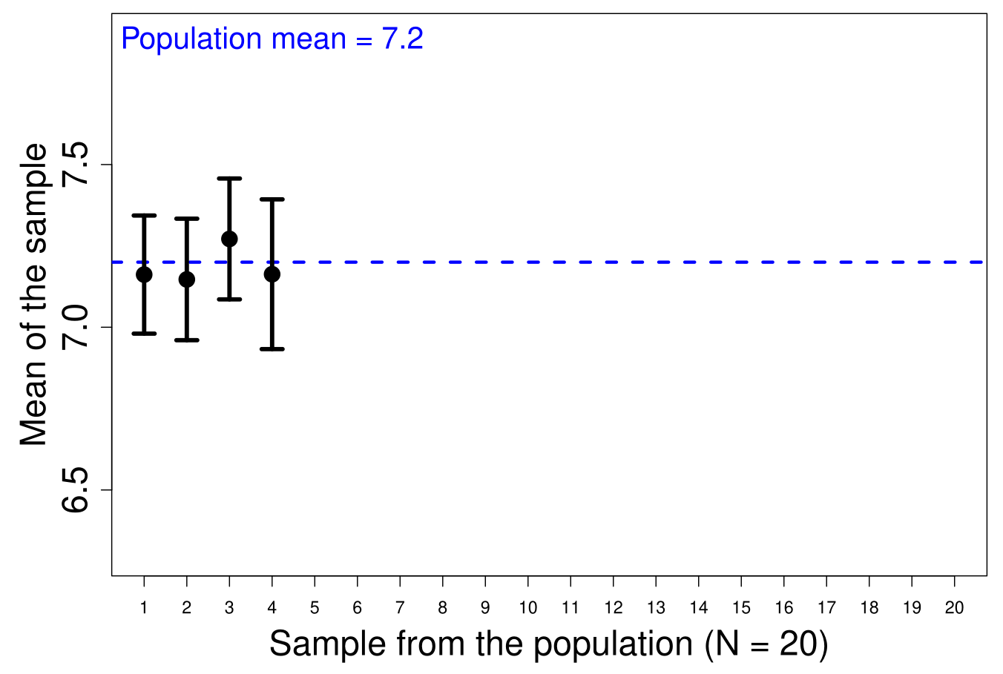
Confidence in a sampled mean value (80%)

Slide 6
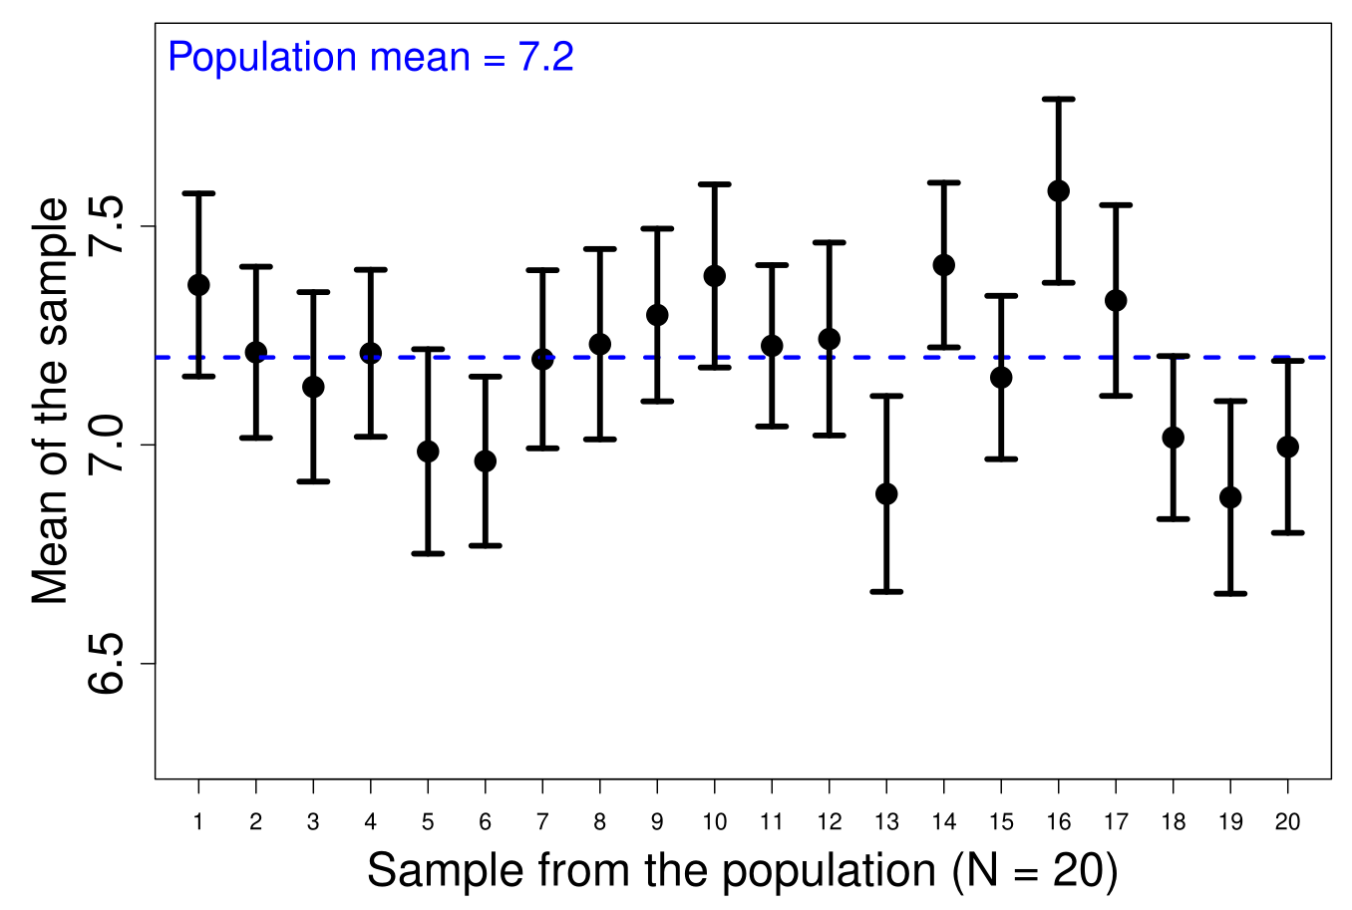
Confidence in a sampled mean value (80%)

Slide 7
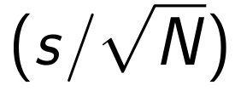
Confidence in sampled mean value
The goal of CIs is to contain uncertainty:
How frequently will the CIs that we draw contain the population mean (μ_{x})?
Distribution probabilities (e.g., z-scores)
The standard error

Slide 8
Confidence in sampled mean value
Calculating CIs
LCI = x̄ - z
UCI = x̄ + z

Slide 9
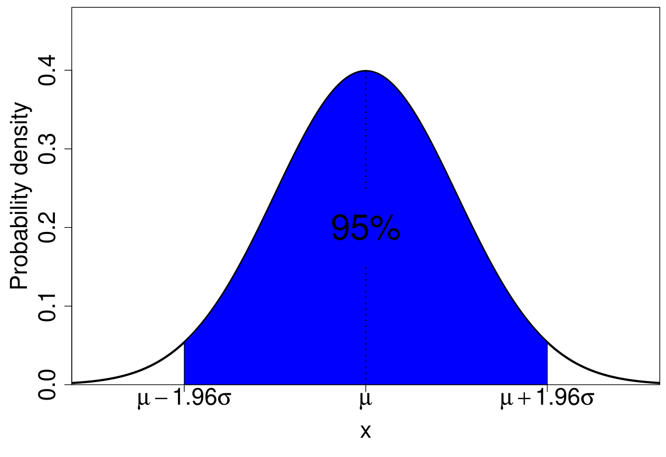
Probabilities calculated from the normal distribution
https://bradduthie.github.io/stats/app/zandp/

Slide 10
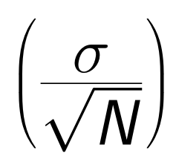
Confidence in sampled mean value
Really assuming s = σ
LCI = x̄ - z
UCI = x̄ + z

Slide 11
Confidence in sampled mean value
Problem assuming: s = σ
Assuming no uncertainty in estimation of standard deviation (σ)
If uncertainty in σ, our CIs will be wrong

Slide 12
Confidence in sampled mean value
Problem assuming: s = σ
Problem less relevant¹ for large (N > 30) sample sizes
Low sample size increases uncertainty of standard deviation
Sokal, RR & FJ Rohlf. 1995. Biometry. 3rd ed. WH Freeman & Company, New York, USA.

Slide 13

Confidence in a sampled mean value
Uncertainty in the standard deviation?
Need to adjust the normal distribution

Slide 14
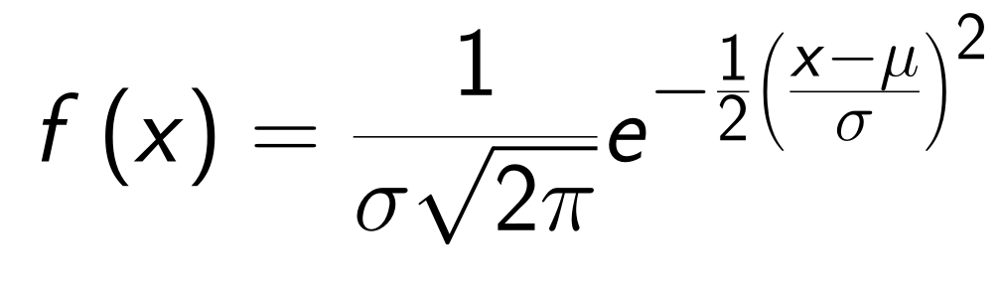
The normal distribution
You do not need to know this equation.

Slide 15
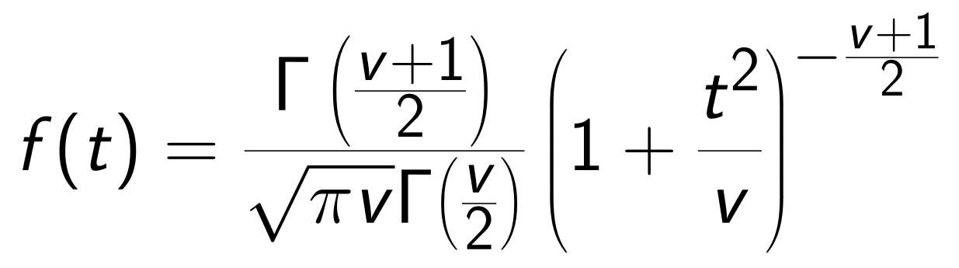

The t-distribution
Forget the equation, see: https://bradduthie.github.io/stats/app/t_score/

Slide 16
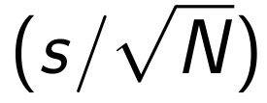
Confidence intervals with a normal distribution
Verbally
LCI = Mean — (z-score × standard error)
UCI = Mean + (z-score × standard error)
Mathematically
LCI = x̄ - z
UCI = x̄ + z

Slide 17
Confidence intervals with a t-distribution
Verbally
LCI = Mean — (t-score × standard error)
UCI = Mean + (t-score × standard error)
Mathematically
LCI = x̄ - t
UCI = x̄ + t

Slide 18
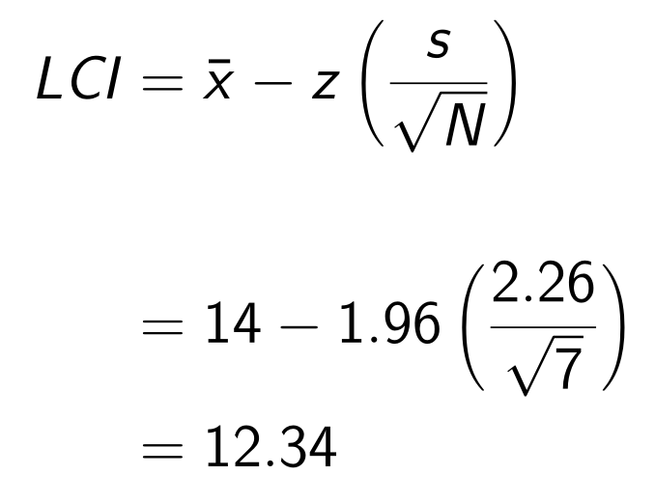
Confidence intervals with normal distribution
x₁ | x₂ | x₃ | x₄ | x₅ | x₆ | x₇
17.1 | 15.2 | 14.9 | 12.6 | 15.2 | 10.3 | 12.7
N = 7 x̄ = 14 s = 2.26 z = 1.96 df = ∞

Slide 19
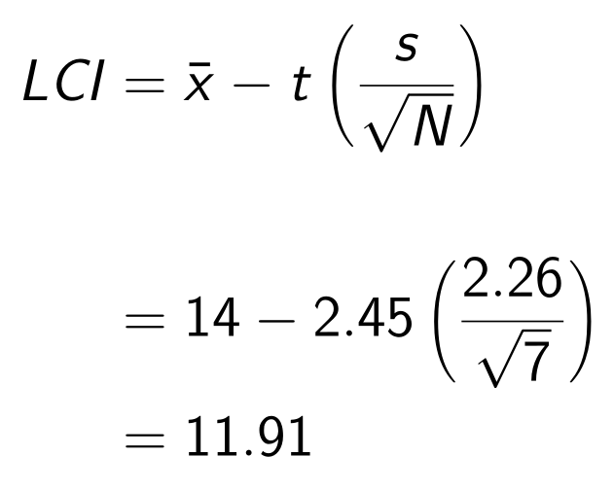
Confidence intervals with t-distribution
x₁ | x₂ | x₃ | x₄ | x₅ | x₆ | x₇
17.1 | 15.2 | 14.9 | 12.6 | 15.2 | 10.3 | 12.7
N = 7 x̄ = 14 s = 2.26 t = 2.45 df = 6

Slide 20
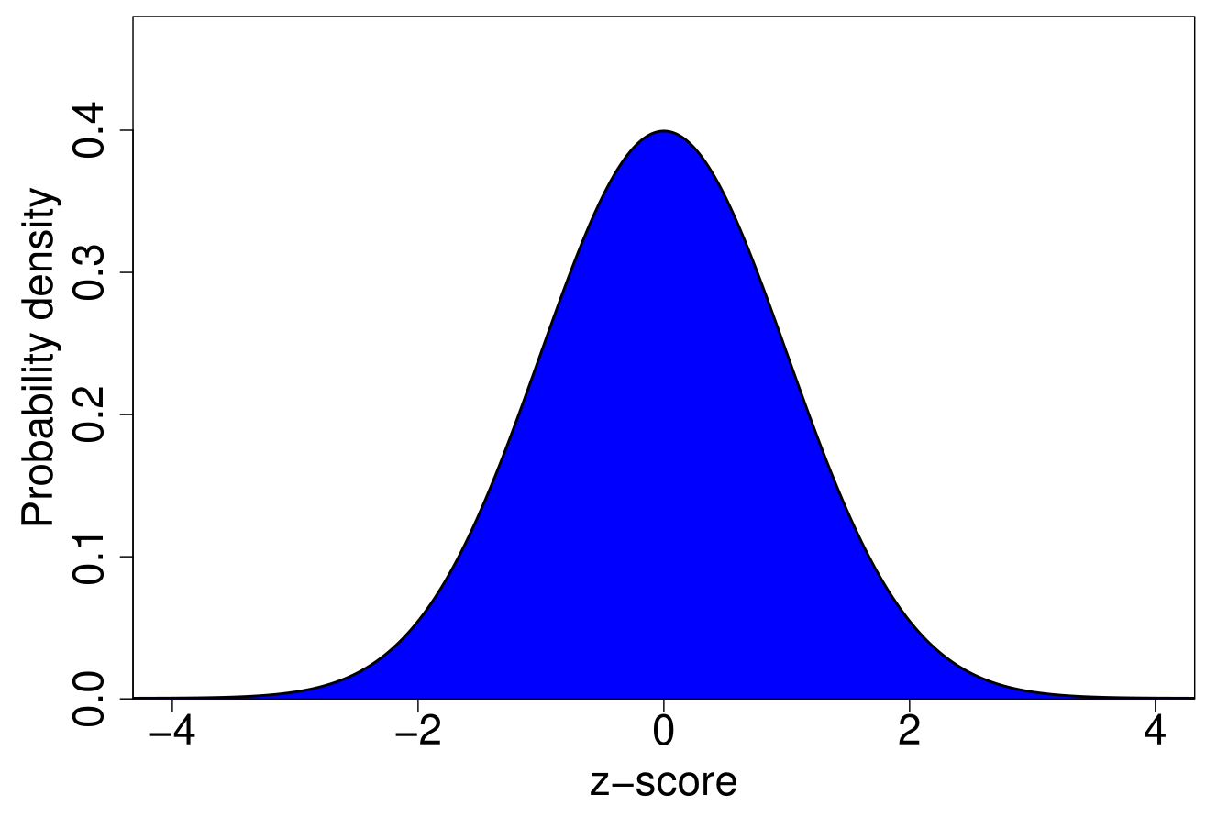
Standard normal distribution
https://bradduthie.github.io/stats/app/zandp/

Slide 21
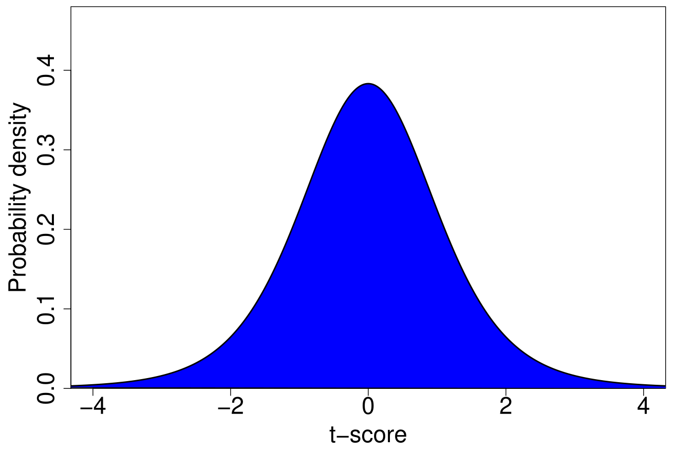
The t-distribution (6 df)
https://bradduthie.github.io/stats/app/t_score/

Slide 22
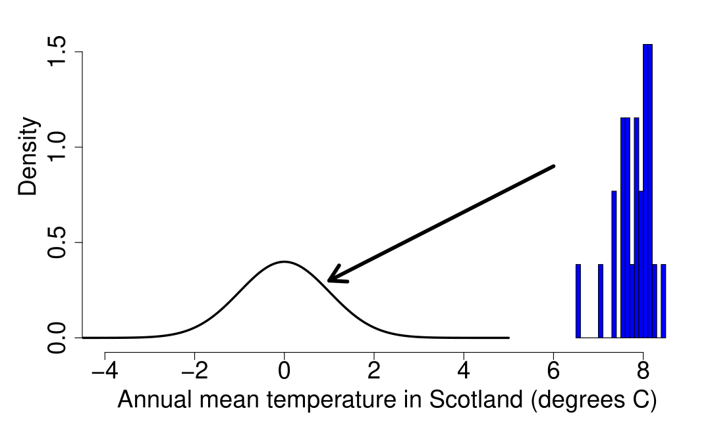
Turning a value into z-score

Slide 23
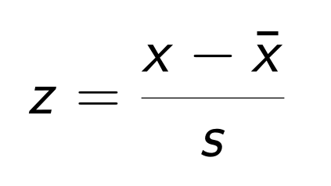
Translating a variable into a standard normal distribution
Subtract mean
Divide by standard deviation
Can turn x-values into z-scores

Slide 24
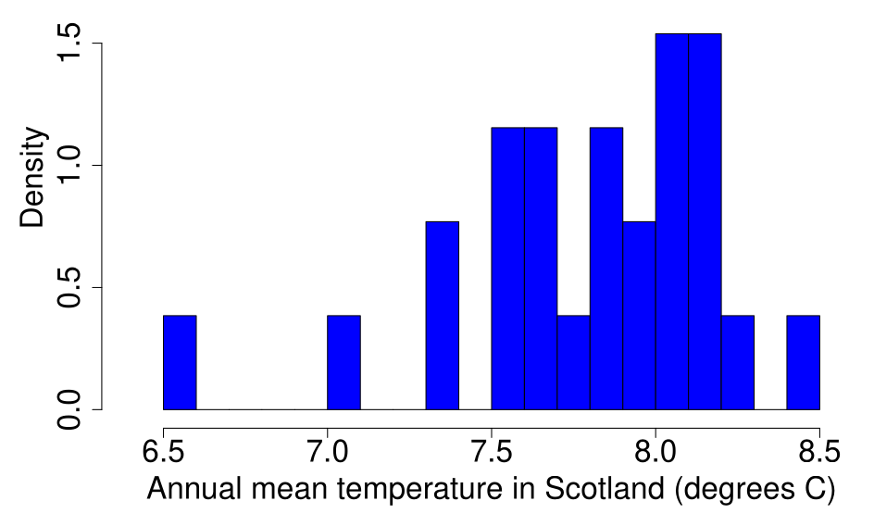
What if the population mean is really 8.0?
N = 26 x̄ = 7.789 s = 0.4124844
Met Office. (July 1, 2021). Annual mean temperature in Scotland from 1995 to 2020. In Statista. Retrieved February 10, 2026, from https://www.statista.com/statistics/367853/scotland-average-temperature/

Slide 25
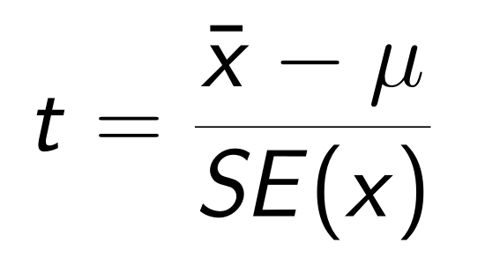
Testing a hypothesis with the t-distribution
Subtract hypothesised mean
Divide by standard deviation
If μ is the population mean, what is the probability of getting x̄?

Slide 26
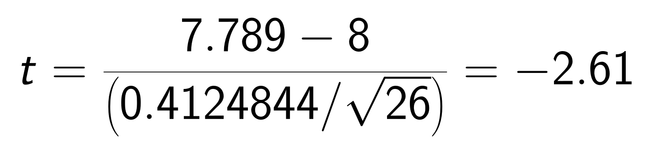
Testing a hypothesis with the t-distribution
Subtract hypothesised mean
Divide by standard deviation
If 8 is the population mean, what is the probability of getting 7.789?

Slide 27
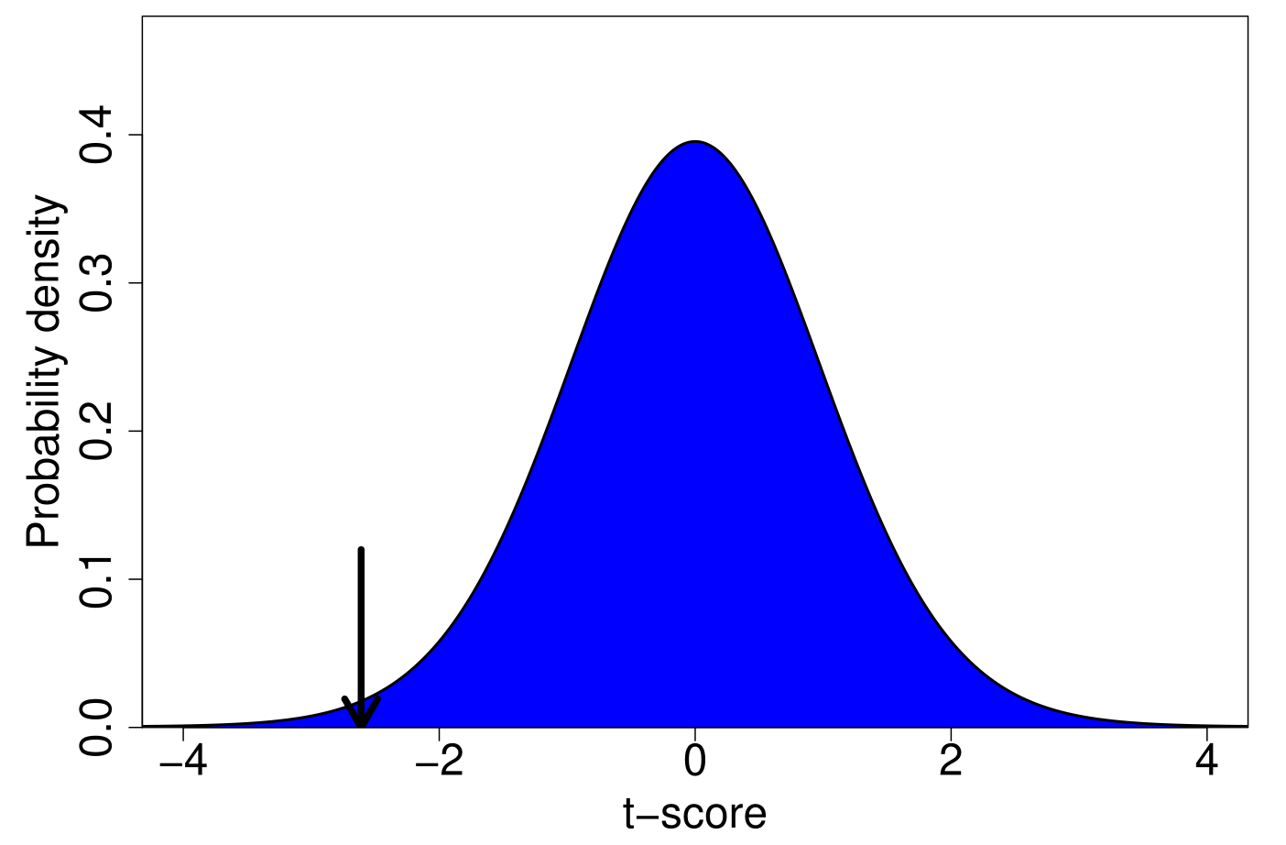
The t-distribution (25 df)
https://bradduthie.github.io/stats/app/t_score/

